Slide 1
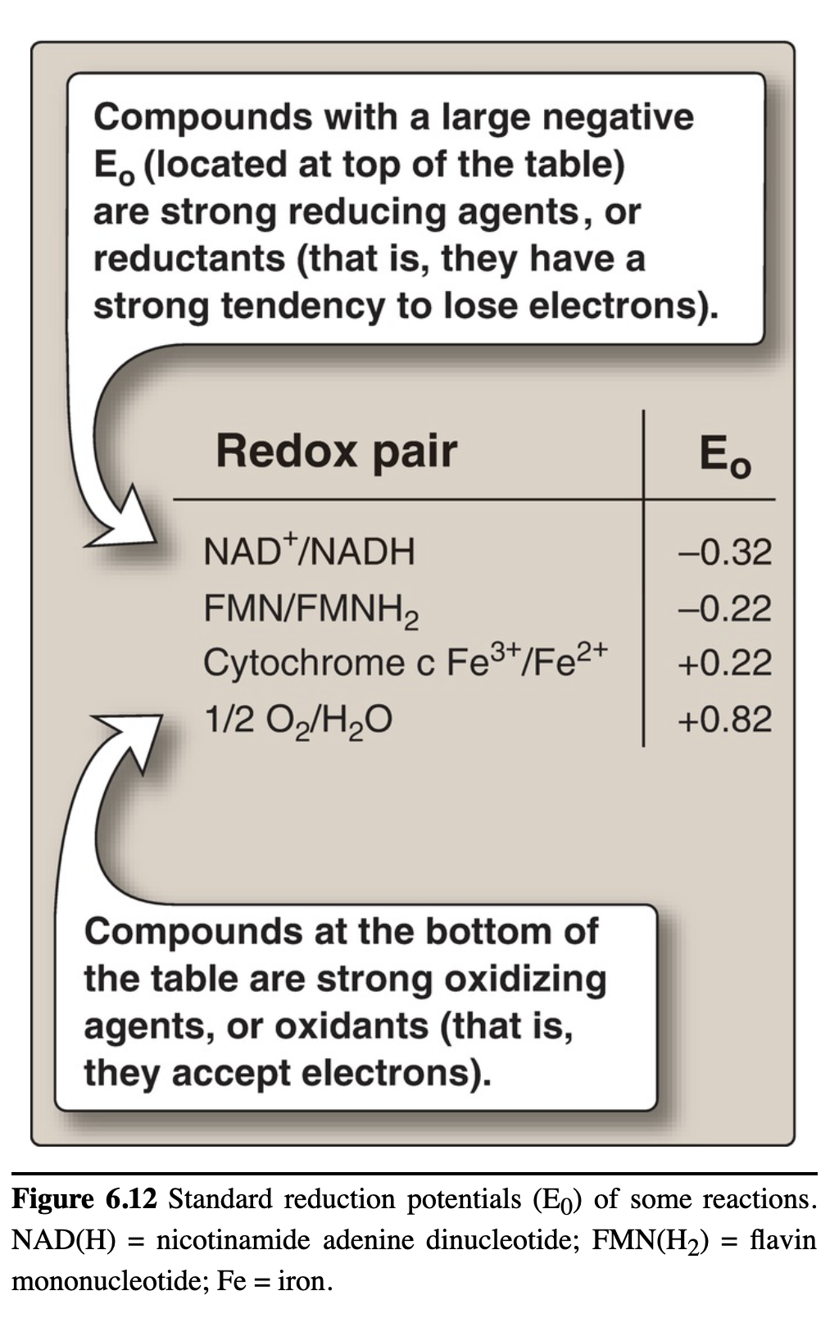
Reduction Potential Determines Flow of Electrons
Reduction potential (E)
affinity for electrons; higher E, higher affinity
electrons transferred from lower to higher E
ΔE°’ = −(RT/nF)ln (K_{eq}) = ΔG°’/nF
∆E°’ = E°’_{(e−} _{acceptor)} – E°’_{(e−} _{donor)}
∆G°’ = –nF∆E°’
For negative ΔG, need positive ΔE
E_{(acceptor)} > E_{(donor)}

Slide 2
TABLE 13-7a | Standard Reduction Potentials of Some Biologically Important Half-Reactions
Half-reaction |  | E'˚ (V)
¹/₂ O₂ + 2H⁺ + 2e– → H₂O |  | 0.816
Fe³⁺ + e– → Fe²⁺ |  | 0.771
NO₃– + 2H⁺ + 2e– → NO₂– + H₂O |  | 0.421
Cytochrome f (Fe³⁺) + e– → cytochrome f (Fe²⁺) |  | 0.365
Fe(CN)₆^{3–} (ferricyanide) + e– → Fe(CN)₆^{4–} |  | 0.36
Cytochrome a₃ (Fe³⁺) + e– → cytochrome a₃ (Fe²⁺) |  | 0.35
O₂ + 2H⁺ + 2e– → H₂O₂ |  | 0.295
Cytochrome a (Fe³⁺) + e– → cytochrome a (Fe²⁺) |  | 0.29
Cytochrome c (Fe³⁺) + e– → cytochrome c (Fe²⁺) |  | 0.254
Cytochrome c₁ (Fe³⁺) + e– → cytochrome c₁ (Fe²⁺) |  | 0.22
Cytochrome b (Fe³⁺) + e– → cytochrome b (Fe²⁺) |  | 0.077
Ubiquinone + 2H⁺ + 2e– → ubiquinol |  | 0.045
Fumarate^{2–} + 2H⁺ + 2e– → succinate2– |  | 0.031
2H⁺ + 2e– → H₂ (at standard conditions, pH 0) |  | 0.000
Crotonyl-CoA + 2H⁺ + 2e– → butyryl-CoA |  | –0.015
Oxaloacetate^{2–} + 2H⁺ + 2e– → malate^{2–} |  | –0.166
Source: Data mostly from R. A. Loach, in Handbook of Biochemistry and Molecular Biology, 3rd edn (G. D. Fasman, ed.), Physical and Chemical Data, Vol. 1, p. 122, CRC Press, 1976. ªThis is the value for free FAD; FAD bound to a specific flavoprotein (e.g., succinate dehydrogenase) has a different E'˚ that depends on its protein environment.

Slide 3
TABLE 13-7b | Standard Reduction Potentials of Some Biologically Important Half-Reactions
Half-reaction |  | E'˚ (V)
Pyruvate– + 2H + 2e– → lactate– |  | –0.185
Acetaldehyde + 2H⁺ + 2e– → ethanol |  | –0.197
FAD + 2H+ + 2e– → FADH₂ |  | –0.219ª
Glutathione + 2H⁺ + 2e– → 2 reduced glutathione |  | –0.23
S + 2H⁺ + 2e– → H₂S |  | –0.243
Lipoic acid + 2H⁺ + 2e– → dihydrolipoic acid |  | –0.29
NAD⁺ + H⁺ + 2e– → NADH |  | –0.320
NADP⁺ + H⁺ + 2e– → NADPH |  | –0.324
Acetoacetate + 2H⁺ + 2e– → β-hydroxybutyrate |  | –0.346
α-Ketoglutarate + CO₂ + 2H⁺ + 2e– → isocitrate |  | –0.38
2H⁺ + 2e– → H₂ (at pH 7) |  | –0.414
Ferredoxin (Fe³⁺) + e– → ferredoxin (Fe²⁺) |  | –0.432
Source: Data mostly from R. A. Loach, in Handbook of Biochemistry and Molecular Biology, 3rd edn (G. D. Fasman, ed.), Physical and Chemical Data, Vol. 1, p. 122, CRC Press, 1976. ªThis is the value for free FAD; FAD bound to a specific flavoprotein (e.g., succinate dehydrogenase) has a different E'˚ that depends on its protein environment.

Slide 4
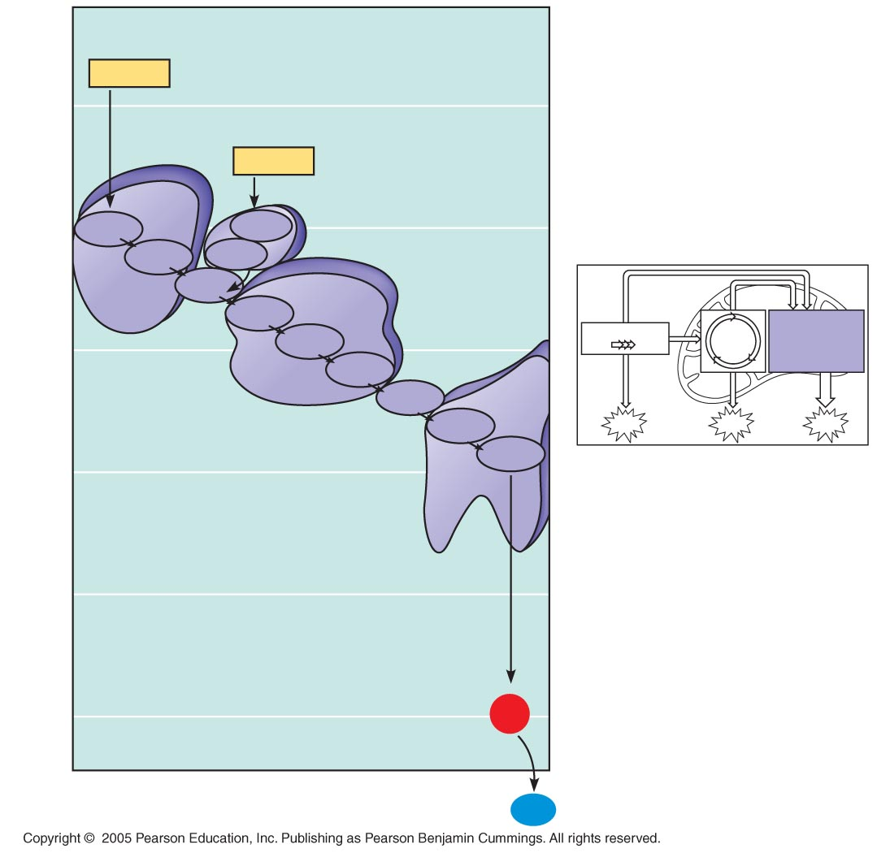
Free energy change during electron transport
NADH
50
FADH₂
Multiprotein
complexes
40
FMN
I
FAD
Fe•S
Fe•S
II
Q
III
Oxidative
phosphorylation:
electron transport
and chemiosmosis
Cyt b
Citric
acid
cycle
30
Fe•S
Glycolysis
Free energy (G) relative to O2 (kcal/mol)
Cyt c₁
IV
Cyt c
ATP
Cyt a
ATP
ATP
Cyt a₃
20
10
0
2 H⁺ + ¹/2
O₂
H₂O

Slide 5
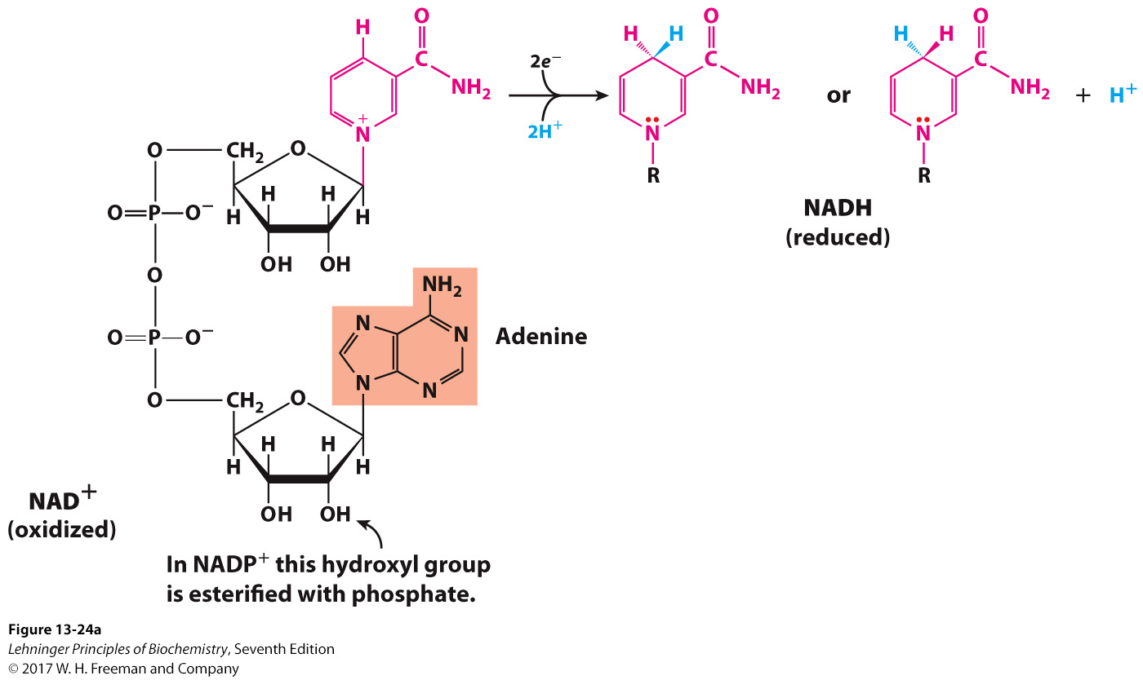
NAD and NADP Are Common Redox Cofactors
These are commonly called pyridine nucleotides.
They can dissociate from the enzyme after the reaction.
In a typical biological oxidation reaction, hydride from an alcohol is transferred to NAD⁺, giving NADH.

Slide 6
NIACIN (VITAMIN B3)
Distribution: Niacin is found in unrefined and enriched grains and cereal, milk, and lean meats (especially liver).
Clinical indications for niacin
Deficiency: A deficiency of niacin causes pellagra, a disease involving the skin, gastrointestinal tract, and CNS. The symptoms of pellagra progress through the three Ds: dermatitis (photosensitive), diarrhea, and dementia. If untreated, death (a fourth D) occurs. Hartnup disorder, characterized by defective absorption of tryptophan, can result in pellagra-like symptoms. [Note: Corn is low in both niacin and tryptophan. Corn-based diets can cause pellagra.]

Slide 7
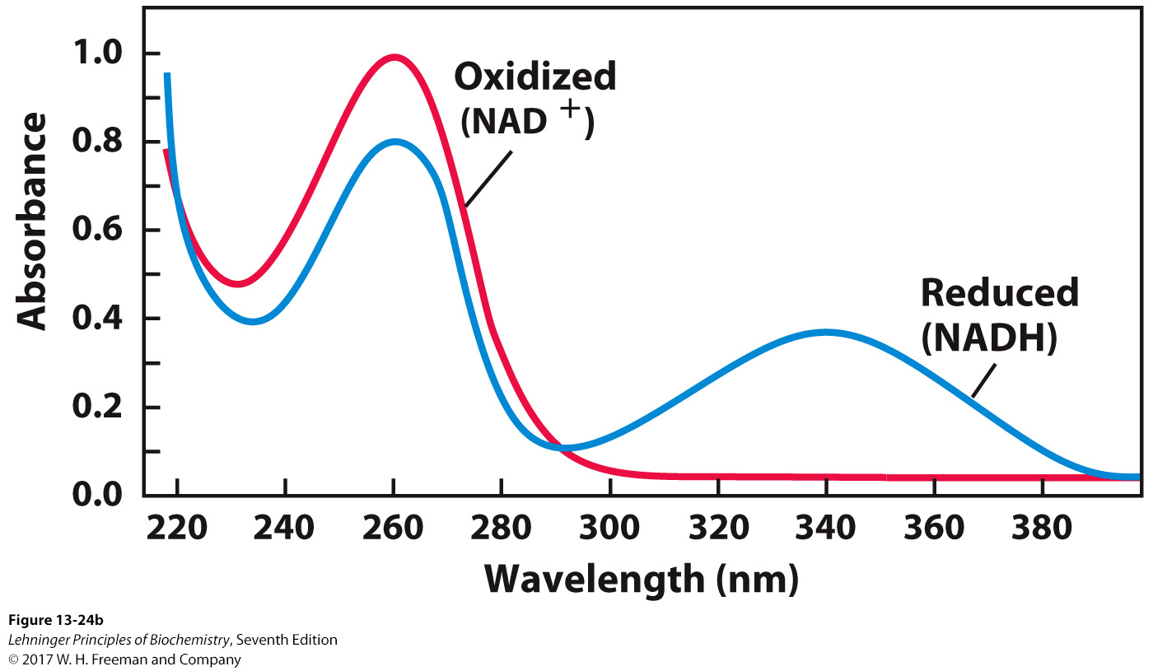
Formation of NADH Can Be Monitored
by UV-Spectrophotometry
Measure the change of absorbance at 340 nm
Very useful signal when studying the kinetics of
NAD-dependent dehydrogenases
Notes:
FIGURE 13-24b NAD and NADP. (b) The UV absorption spectra of NAD⁺ and NADH. Reduction of the nicotinamide ring produces a new, broad absorption band with a maximum at 340 nm. The production of NADH during an enzyme-catalyzed reaction can be conveniently followed by observing the appearance of the absorbance at 340 nm (molar extinction coefficient ε₃₄₀ 5 6,200 M⁻¹ cm⁻¹).

Slide 8
Lesson in Quantum Chemistry
Most organic molecules, including the reduced fuels, are in the singlet spin state.
All electrons are paired into electron pairs.
Molecular oxygen is in the triplet spin state.
Two electrons are unpaired.
Direct electron transfer from a singlet reduced species to a triplet-oxidizing species is quantum-mechanically unfavorable.
This is why direct oxidation (spontaneous combustion) of biomolecules does not occur readily.
Cofactors, such as transition metal ions and flavin adenine dinucleotide, are able to catalyze consecutive single-electron transfers needed for utilization of O₂.

Slide 9
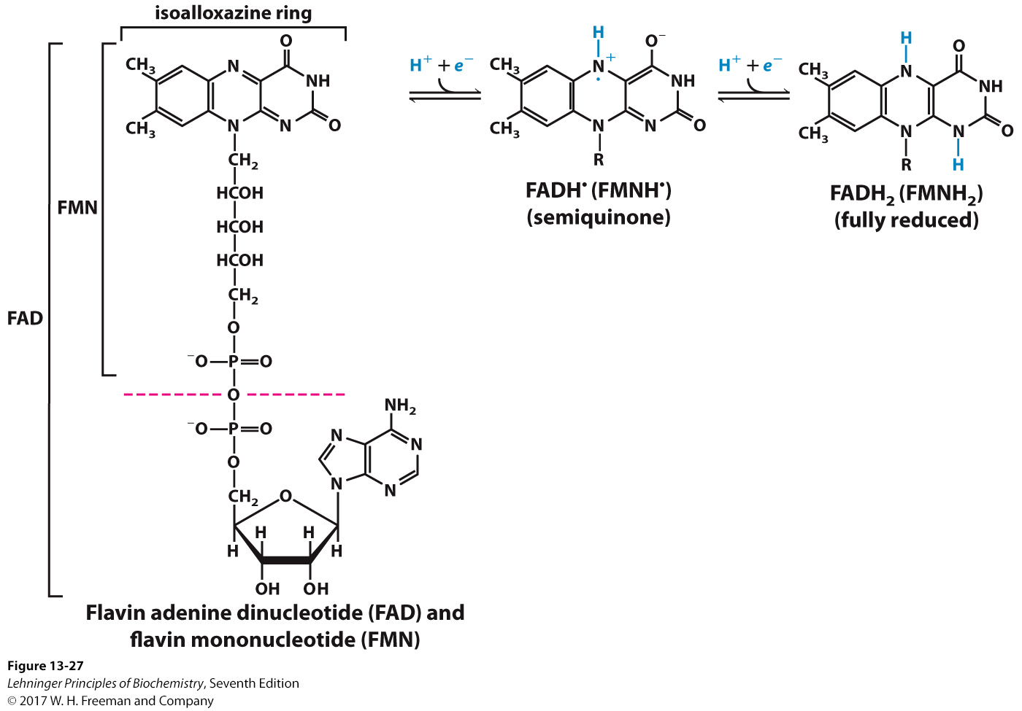
Flavin Cofactors Allow Single Electron Transfers
Permits the use of molecular oxygen as an ultimate electron acceptor
flavin-dependent oxidases
Flavin cofactors are tightly bound to proteins.
Notes:
FIGURE 13–27 Oxidized and reduced FAD and FMN. FMN consists of the structure above the dashed line on the FAD (oxidized form). The flavin nucleotides accept two hydrogen atoms (two electrons and two protons), both of which appear in the flavin ring system. When FAD or FMN accepts only one hydrogen atom, the semiquinone, a stable free radical, forms.

Slide 10
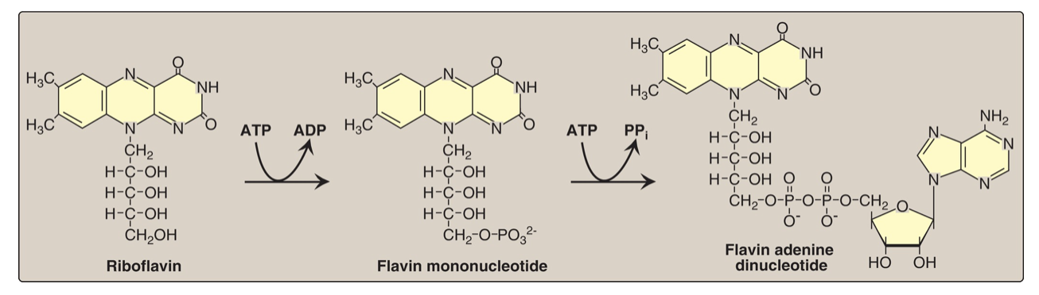
RIBOFLAVIN (VITAMIN B2)
The two biologically active forms of B2 are flavin mononucleotide (FMN) and flavin adenine dinucleotide (FAD), formed by the transfer of an adenosine monophosphate moiety from ATP to FMN (Fig. 28.15). FMN and FAD are each capable of reversibly accepting two hydrogen atoms, forming FMNH2 or FADH2, respectively. FMN and FAD are bound tightly, sometimes covalently, to flavoenzymes (for example, NADH dehydrogenase [FMN] and succinate dehydrogenase [FAD]) that catalyze the oxidation or reduction of a substrate. Riboflavin deficiency is not associated with a major human disease, although it frequently accompanies other vitamin deficiencies. Deficiency symptoms include dermatitis, cheilosis (fissuring at the corners of the mouth), and glossitis (the tongue appearing smooth and dark).

Slide 11
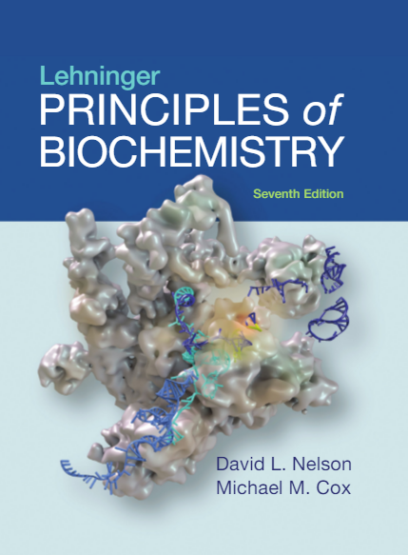
19| Oxidative Phosphorylation
© 2017 W. H. Freeman and Company

Slide 12
Energy from Reduced Fuels Is Used to Synthesize ATP in Animals
Carbohydrates, lipids, and amino acids are the main reduced fuels for the cell.
Electrons from reduced fuels are transferred to reduced cofactors NADH or FADH₂.
In oxidative phosphorylation, energy from NADH and FADH₂ is used to make ATP.

Slide 13
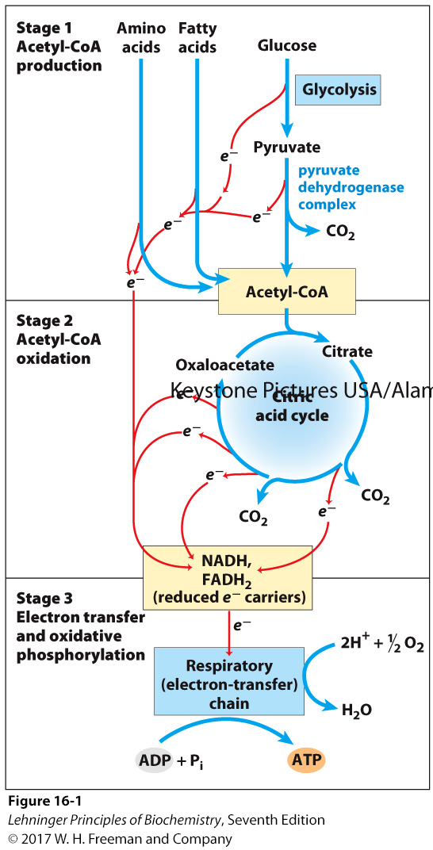
Energy Flow in Cellular Respiration
Notes:
FIGURE 16–1 Catabolism of proteins, fats, and carbohydrates in the three stages of cellular respiration. Stage 1: oxidation of fatty acids, glucose, and some amino acids yields acetyl-CoA. Stage 2: oxidation of acetyl groups in the citric acid cycle includes four steps in which electrons are abstracted. Stage 3: electrons carried by NADH and FADH₂ are funneled into a chain of mitochondrial (or, in bacteria, plasma membrane–bound) electron carriers—the respiratory chain—ultimately reducing O₂ to H₂O. This electron flow drives the production of ATP.

Slide 14
Chemiosmotic Theory
ADP + P_{i} → ATP is highly thermodynamically unfavorable.
How do we make it possible?
Phosphorylation of ADP is not a result of a direct reaction between ADP and some high-energy phosphate carrier.
Energy needed to phosphorylate ADP is provided by the flow of protons down the electrochemical gradient.
The energy released by electron transport is used to transport protons against the electrochemical gradient.

Slide 15
Chemiosmotic Energy Coupling Requires Membranes
The proton gradient needed for ATP synthesis can be stably established across a membrane that is impermeable to ions.
plasma membrane in bacteria
inner membrane in mitochondria
thylakoid membrane in chloroplasts
The membrane must contain proteins that couple the “downhill” flow of electrons in the electron-transfer chain with the “uphill” flow of protons across the membrane.
The membrane must contain a protein that couples the “downhill” flow of protons to the phosphorylation of ADP.

Slide 16
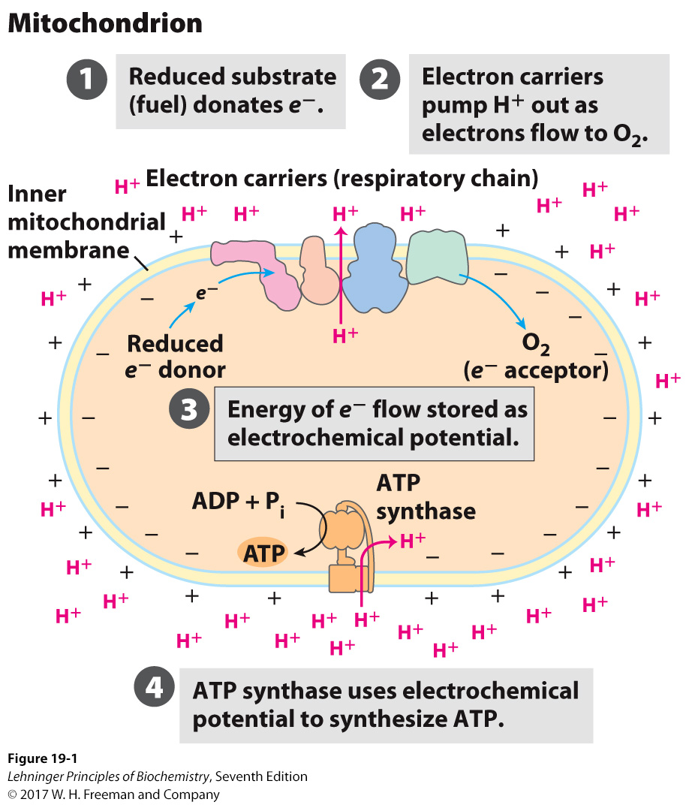
Chemiosmotic Theory
Notes:
FIGURE 19–1 The chemiosmotic mechanism for ATP synthesis in mitochondria. Electrons move spontaneously through a chain of membrane-bound carriers, the respiratory chain, driven by the high reduction potential of oxygen and the relatively low reduction potentials of the various reduced substrates (fuels) that undergo oxidation in the mitochondrion. Electron flow creates an electrochemical potential by the transmembrane movement of protons and positive charge. This electrochemical potential drives ATP synthesis by a membrane-bound enzyme, ATP synthase, that is fundamentally similar in mitochondria and chloroplasts, and in bacteria and archaea as well.

Slide 17
Structure of a Mitochondrion
Double membrane leads to four distinct compartments:
Outer membrane:
relatively porous membrane; allows passage of metabolites
Intermembrane space (IMS):
similar environment to cytosol
higher proton concentration (lower pH)
Inner membrane
relatively impermeable, with proton gradient across it
location of electron transport chain complexes
Convolutions called cristae serve to increase the surface area.
Matrix
location of the citric acid cycle and parts of lipid and amino acid metabolism
lower proton concentration (higher pH)

Slide 18
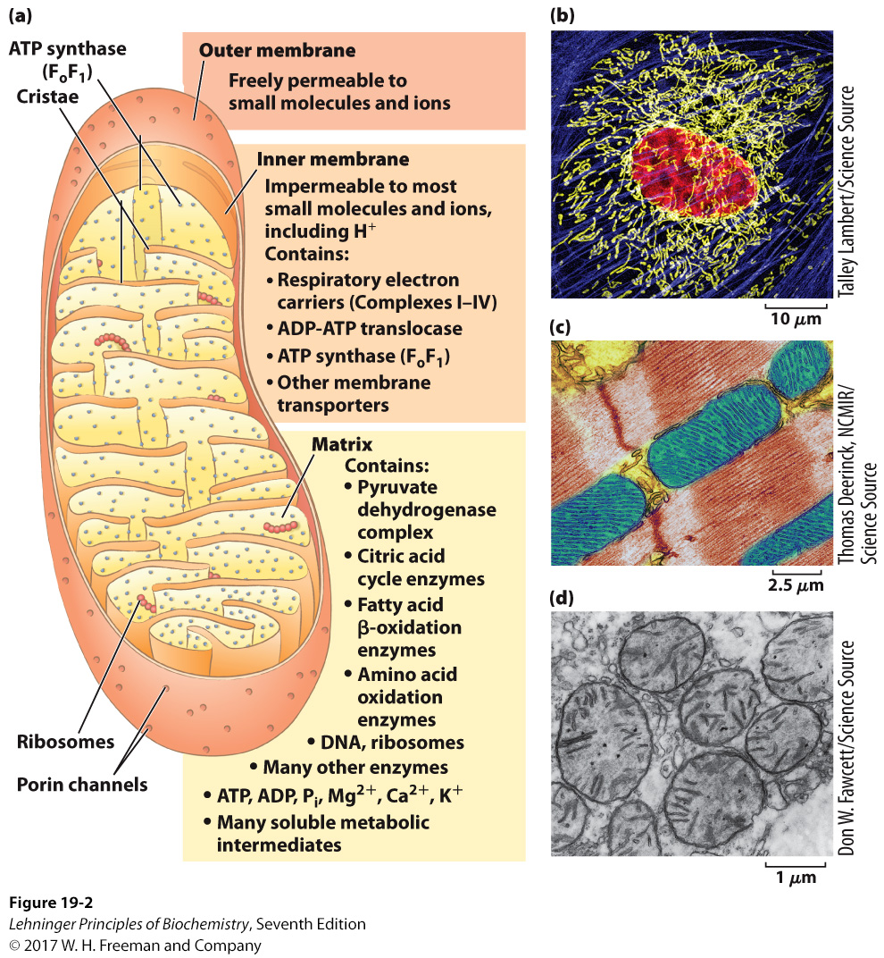
Structure of a Mitochondrion
Notes:
FIGURE 19–2 Biochemical anatomy of a mitochondrion. (a) The outer membrane has pores that make it permeable to small molecules and ions, but not to proteins. The convolutions of the inner membrane, called cristae, provide a very large surface area. The inner membrane of a single liver mitochondrion may have more than 10,000 sets of electron-transfer systems (respiratory chains) and ATP synthase molecules, distributed over the membrane surface. (b) A typical animal cell has hundreds or thousands of mitochondria. This endothelial cell from bovine pulmonary artery was stained with fluorescent probes for actin (blue), for DNA (red), and for mitochondria (yellow). Notice the variability in length of the mitochondria. (c) The mitochondria of heart muscle (blue in this colorized electron micrograph) have more profuse cristae and thus a much larger area of inner membrane, with more than three times as many sets of respiratory chains as (d) liver mitochondria. Muscle and liver mitochondria are about the size of a bacterium—1 to 10 μm long. The mitochondria of invertebrates, plants, and microbial eukaryotes are similar to those shown here, but with much variation in size, shape, and degree of convolution of the inner membrane.

Slide 19
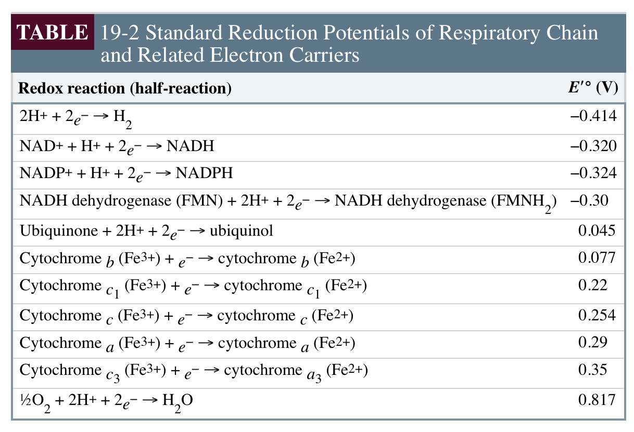
Electron-Transport Chain Complexes Contain a Series of Electron Carriers
Each complex contains multiple redox centers consisting of:
flavin mononucleotide (FMN) or flavin adenine dinucleotide (FAD)
cytochromes a, b, or c
iron-sulfur cluster
Order of transfer of electrons is dependent on reduction potential:

Slide 20
FMN and FAD: Electron Funnels
FMN and FAD can be covalently bound to proteins and act to funnel and distribute electrons.
Accept two electrons from carrier that are unstable with single electrons
Donate one electron at a time to acceptors that can only accept single electrons
Notes:
FIGURE 838 Sequence assembly. In a genomic sequence, each base pair of the genome is usually represented in multiple sequenced fragments, referred to as reads. Shown here is a small part of the genomic sequence of a new variant species of E. coli, with the reads generated by a 454 sequencer. The numbers at the top represent base-pair positions in the genome, relative to an arbitrarily defined reference point. All sequence fragments come from a particular long contig designated 356. The reads are represented by horizontal arrows, with computer-assigned identifiers for each read listed at the left. DNA strand segments are sequenced at random, with sequences obtained from one strand (5’ to 3’, left to right) represented by solid arrows and sequences obtained from the other strand (5’ to 3’, right to left) represented by dashed-line arrows (the latter automatically reported as their complement when they are merged with the overall dataset). The “coverage threshold” at the top is a measure of sequence quality. The wider green bar indicates sequences that have been obtained enough times to generate high confidence in the results; the depth of the coverage line indicates how many times a given base pair appears in a sequenced read. The vertical blue-shaded line indicates a part of the sequence that is highlighted by shading in the sequence line at the bottom of the figure. The “SNP statistics report” (inset) is a listing of positions where sequence changes called single
nucleotide polymorphisms (SNPs; see Chapter 9) seem to be present in some of the reads. These putative SNPs are often checked by additional sequencing. They are indicated in the reads by thin blue vertical slash marks within the horizontal lines for each read.

Slide 21
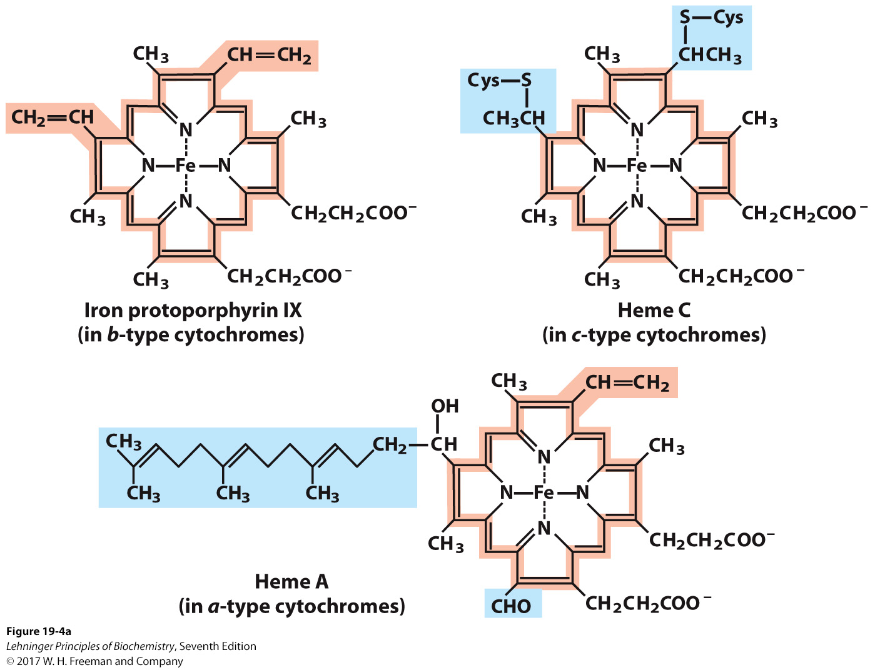
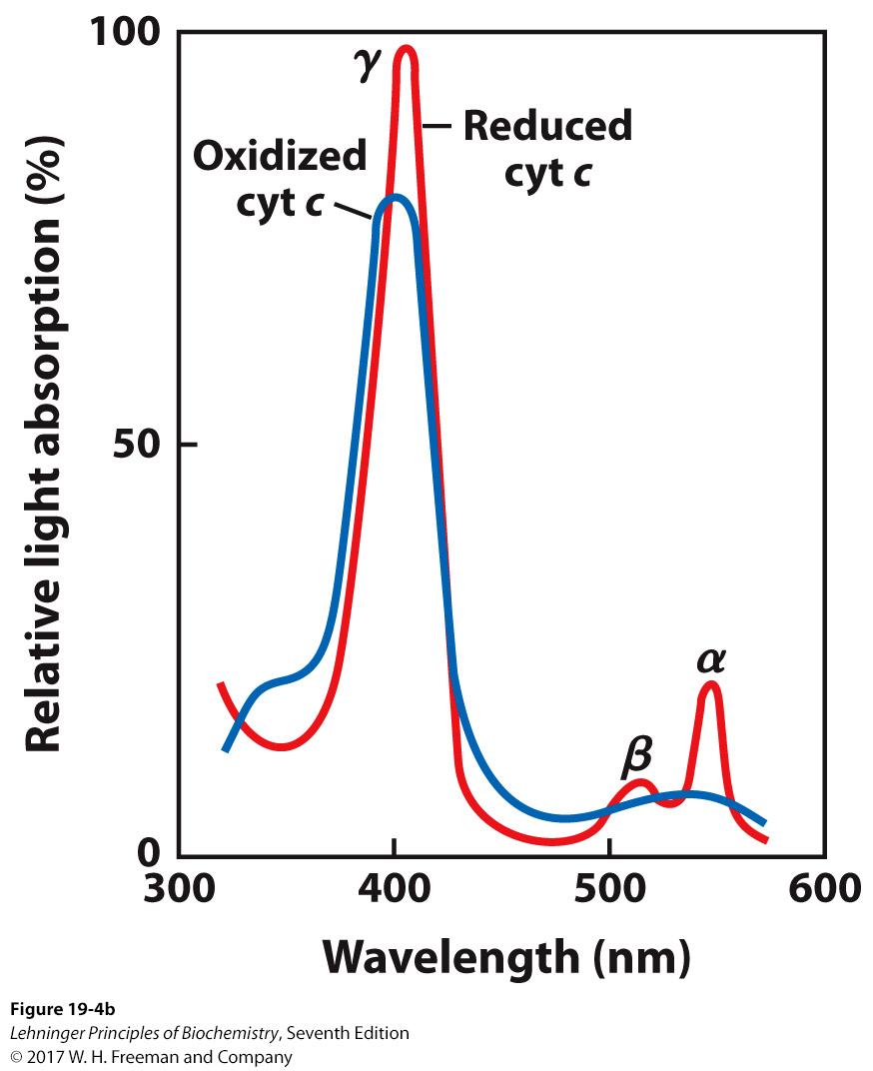
Cytochromes
One-electron carriers
Iron coordinating porphoryin ring derivatives
a, b, or c differ by ring additions
Notes:
FIGURE 19–4 Prosthetic groups of cytochromes. (a) Each group consists of four five-membered, nitrogen-containing rings in a cyclic structure called a porphyrin. The four nitrogen atoms are coordinated with a central Fe ion, either Fe²⁺ or Fe³⁺. Iron protoporphyrin IX is found in b-type cytochromes and in hemoglobin and myoglobin (see Fig. 4–17). Heme c is covalently bound to the protein of cytochrome c through thioether bonds to two Cys residues. Heme a, found in a-type cytochromes, has a long isoprenoid tail attached to one of the five-membered rings. The conjugated double-bond system (shaded light red) of the porphyrin ring has delocalized π electrons that are relatively easily excited by photons with the wavelengths of visible light, which accounts for the strong absorption by hemes (and related compounds) in the visible region of the spectrum. (b) Absorption spectra of cytochrome c (cyt c) in its oxidized (blue) and reduced (red) forms. The characteristic α, β, and γ bands of the reduced form are labeled.

Slide 22
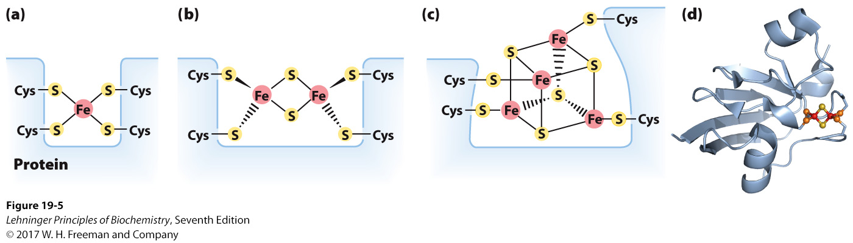
Iron-Sulfur Clusters
One-electron carriers
Coordinating by cysteines in the protein
Containing equal number of iron and sulfur atoms
Friedreich's ataxia
Frataxin protein helps build iron-sulfur centers in neurons
Notes:
FIGURE 19–5 Iron-sulfur centers. The Fe-S centers of iron-sulfur proteins may be as simple as (a), with a single Fe ion surrounded by the S atoms of four Cys residues. Other centers include both inorganic and Cys S atoms, as in (b) 2Fe-2S or (c) 4Fe-4S centers. (d) The ferredoxin of the cyanobacterium Anabaena 7120 has one 2Fe-2S center (PDB ID 1FRD); Fe is red, inorganic S is yellow, and the S of Cys is orange. (Note that in these designations only the inorganic S atoms are counted. For example, in the 2Fe-2S center (b), each Fe ion is actually surrounded by four S atoms.) The exact standard reduction potential of the iron in these centers depends on the type of center and its interaction with the associated protein.

Slide 23
Coenzyme Q or Ubiquinone
Ubiquinone is a lipid-soluble conjugated dicarbonyl compound that readily accepts electrons.
Upon accepting two electrons, it picks up two protons to give an alcohol, ubiquinol.
Ubiquinol can freely diffuse in the membrane, carrying electrons with protons from one side of the membrane to another side.
Coenzyme Q is a mobile electron carrier transporting electrons from Complexes I and II to Complex III.

Slide 24
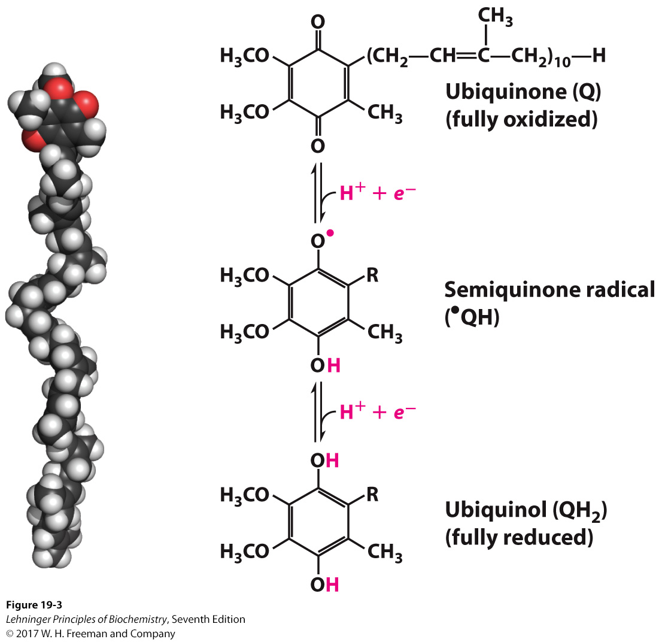
Coenzyme Q or Ubiquinone
Notes:
FIGURE 19–3 Ubiquinone (Q, or coenzyme Q). Complete reduction of ubiquinone requires two electrons and two protons, and occurs in two steps through the semiquinone radical intermediate.

Slide 25
TABLE 19-3 | The Protein Components of the Mitochondrial Respiratory Chain
Enzyme complex/protein |  | Mass (kDa) | Number of subunitsª | Prosthetic group(s)
I NADH dehydrogenase |  | 850 | 45 (14) | FMN, Fe-S
II Succinate dehydrogenase |  | 140 | 4 | FAD, Fe-S
III Ubiquinone: cytochrome c oxidoreductase^{b} |  | 250 | 11 | Hemes, Fe-S
Cytochrome c^{c} |  | 13 | 1 | Heme
IV Cytochrome oxidase^{b} |  | 204 | 13 (3–4) | Hemes; Cu_{A}, Cu_{B}
ªNumber of subunits in the bacterial complexes in parentheses. ^{b}Mass and subunit data are for the monomeric form. ^{c}Cytochrome c is not part of an enzyme complex; it moves between Complexes III and IV as a freely soluble protein.

Slide 26
NADH:Ubiquinone Oxidoreductase, a.k.a. Complex I
One of the largest macro-molecular assemblies in the mammalian cell
Over 40 different polypeptide chains, encoded by both nuclear and mitochondrial genes
NADH binding site in the matrix side
Noncovalently bound flavin mononucleotide (FMN) accepts two electrons from NADH.
Several iron-sulfur centers pass one electron at a time toward the ubiquinone binding site.

Slide 27
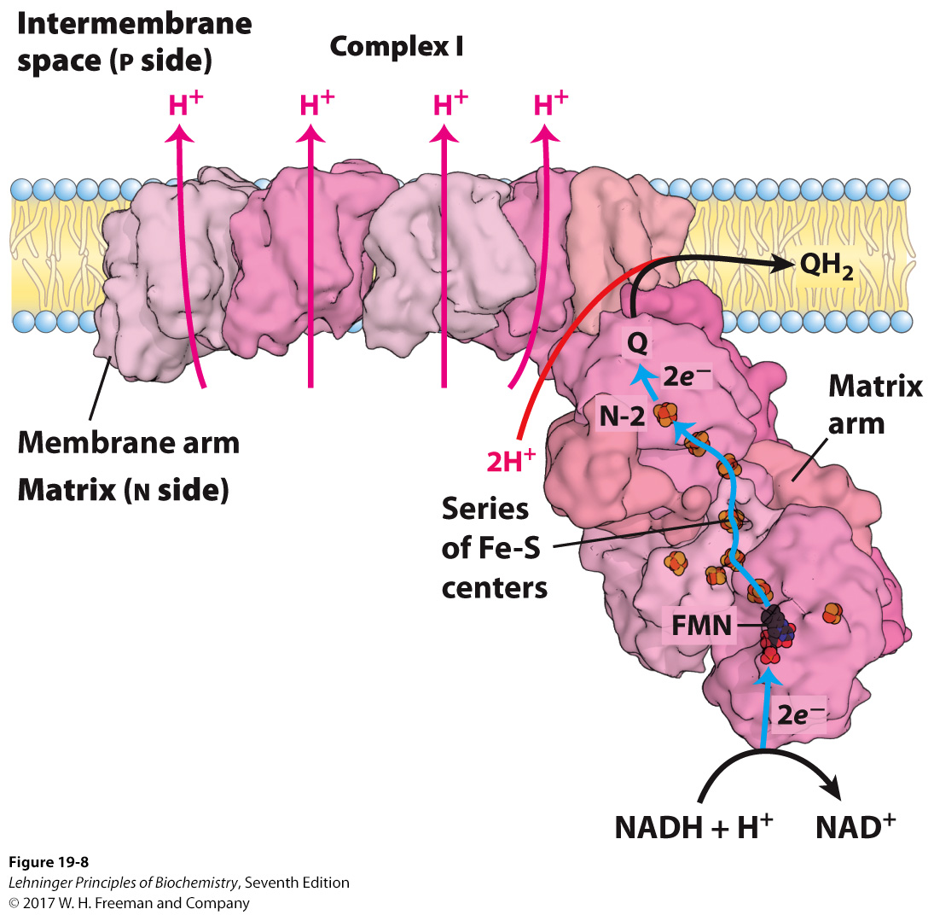
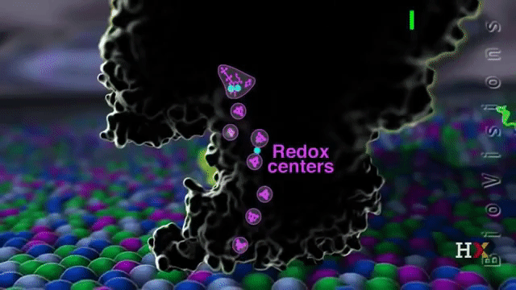
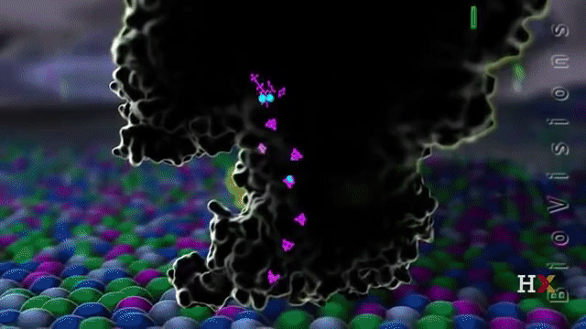
Complex I
2 e- are passed from NADH to Q, yielding QH₂
4 H+ are pumped to p-side
Notes:
FIGURE 19–8 Structure of Complex I (NADH:ubiquinone oxidoreductase). Complex I (shown here is the crystal structure from the bacteriumThermus thermophilus) catalyzes the transfer of a hydride ion from NADHto FMN, and from the FMN, two electrons pass through a series of FeScenters to the Fe-S center N-2 in the matrix arm of the complex. Electrontransfer from N-2 to ubiquinone on the membrane arm forms QH2, which diffuses into the lipid bilayer. This electron transfer also drives expulsion from the matrix of four protons per pair of electrons. Proton flux produces an electrochemical potential across the inner mitochondrial membrane(N side negative, P side positive). The detailed mechanism that couples electron and proton transfer in Complex I is not yet known, but three of the membrane subunits are structurally related to a known Naϩ-Hϩ anti-porter, and the path of proton movement may be similar in both cases. The fourth putative proton pathway is through an integral subunit closer to the Q-binding site. A long helix (not visible in this view) lying along the surface of the membrane arm may coordinate the action of all four proton pumps when Q is reduced.

Slide 28
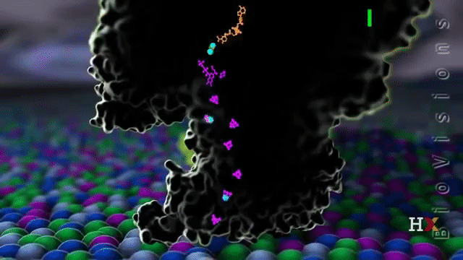
NADH:Ubiquinone Oxidoreducase Is a Proton Pump
Transfer of two electrons from NADH to ubiquinone is accompanied by a transfer of protons from the matrix (N) to the intermembrane space (P) .
Experiments suggest that about four protons are transported across the membrane per one NADH.
NADH + Q + 5H⁺_{N} = NAD⁺ + QH₂ + 4 H⁺_{P}
Reduced coenzyme Q picks up two protons.
Protons are transported by proton wires.
a series of amino acids that undergo protonation and deprotonation to get a net transfer of a proton from one side of a membrane to another

Slide 29
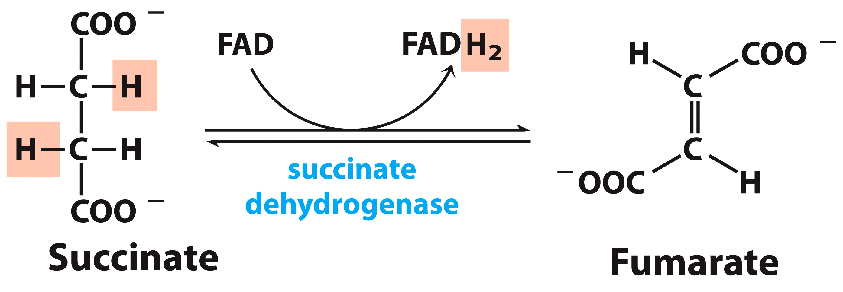
Succinate Dehydrogenase, a.k.a. Complex II
FAD accepts two electrons from succinate.
Electrons are passed, one at a time, via iron-sulfur centers to ubiquinone, which becomes reduced QH₂.
Does not transport protons
Succinate dehydrogenase is a single enzyme with dual roles:
convert succinate to fumarate in the citric acid cycle
capture and donate electrons in the electron transport chain

Slide 30
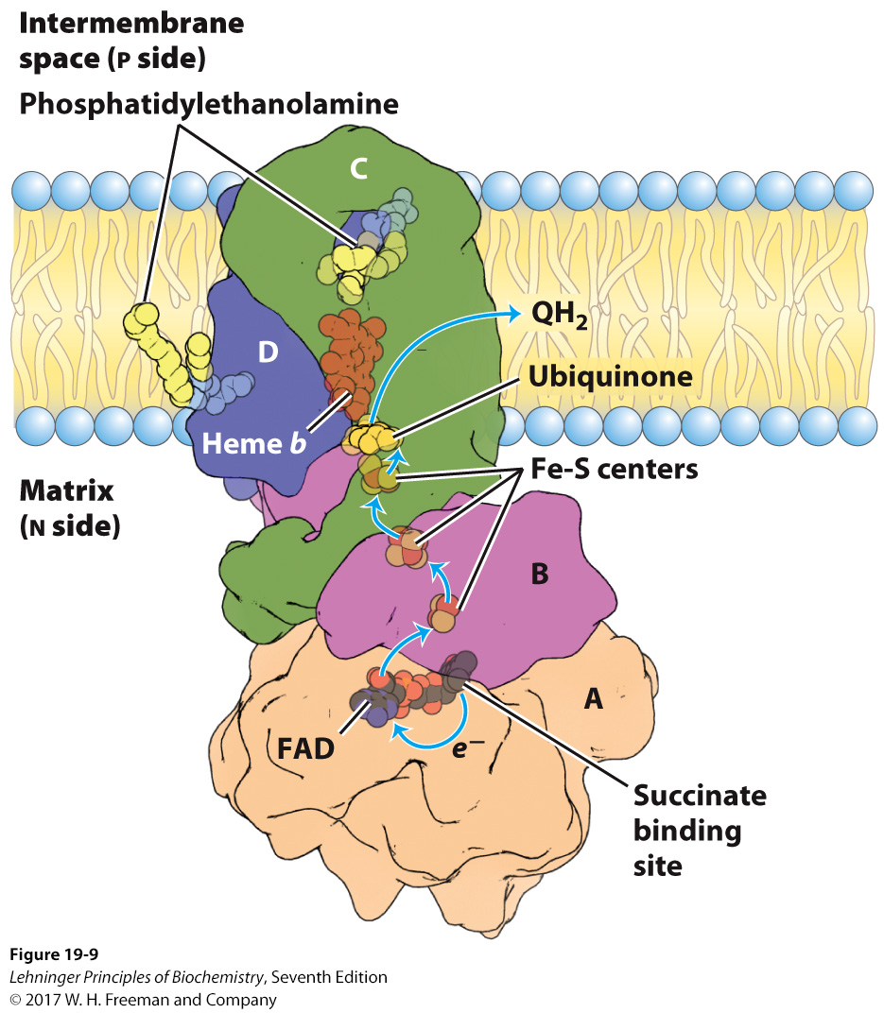
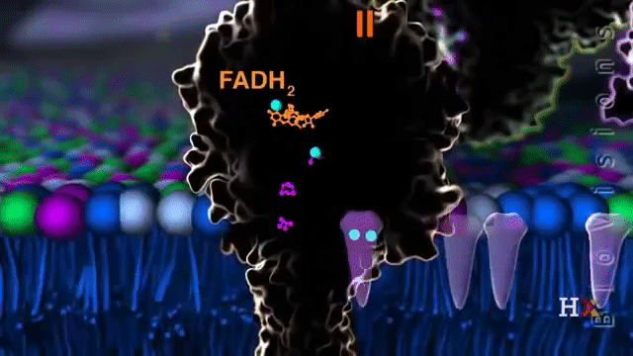
Complex II
2 e- are passed from succcinate to FAD to Q, yielding QH₂
0 H+ are pumped!
Notes:
FIGURE 19–9 Structure of Complex II (succinate dehydrogenase). This complex (porcine) has two transmembrane subunits, C and D; sub-units A and B extend into the matrix. Just behind the FAD in subunit A is the binding site for succinate. Subunit B has three Fe-S centers, ubiquinoneis bound to subunit B, and heme b is sandwiched between subunits C andD. Two phosphatidylethanolamine molecules are so tightly bound to sub-unit D that they show up in the crystal structure. Electrons move (blue arrows) from succinate to FAD, then through the three Fe-S centers to ubiquinone. The heme b is not on the main path of electron transfer but protects against the formation of reactive oxygen species (ROS) by electrons that go astray.

Slide 31
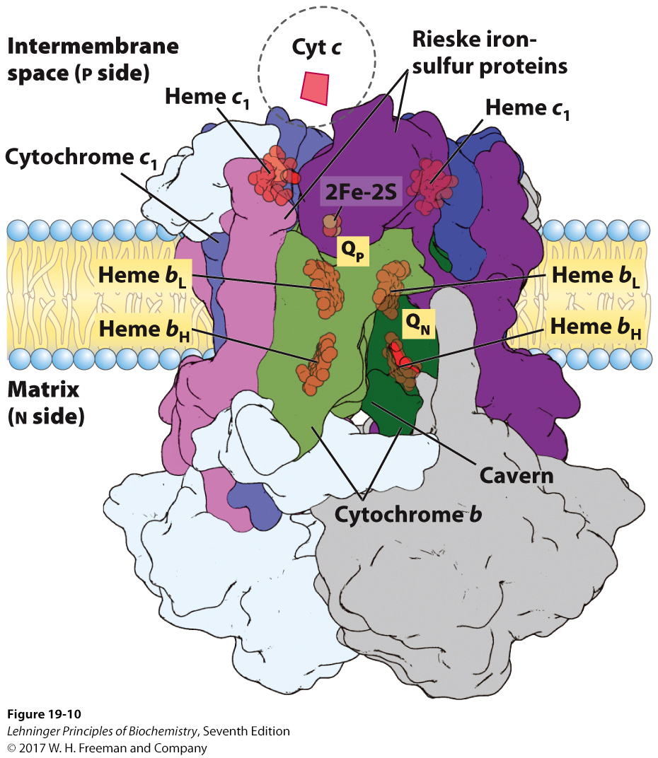
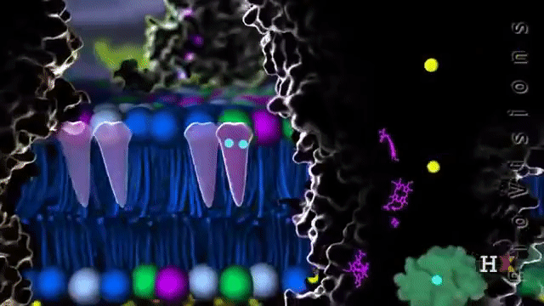
Ubiquinone:Cytochrome c Oxidoreductase, Complex III
Uses two e- from QH₂ to reduce two molecules of cytochrome c
4 H+ are released into p-side.

Slide 32
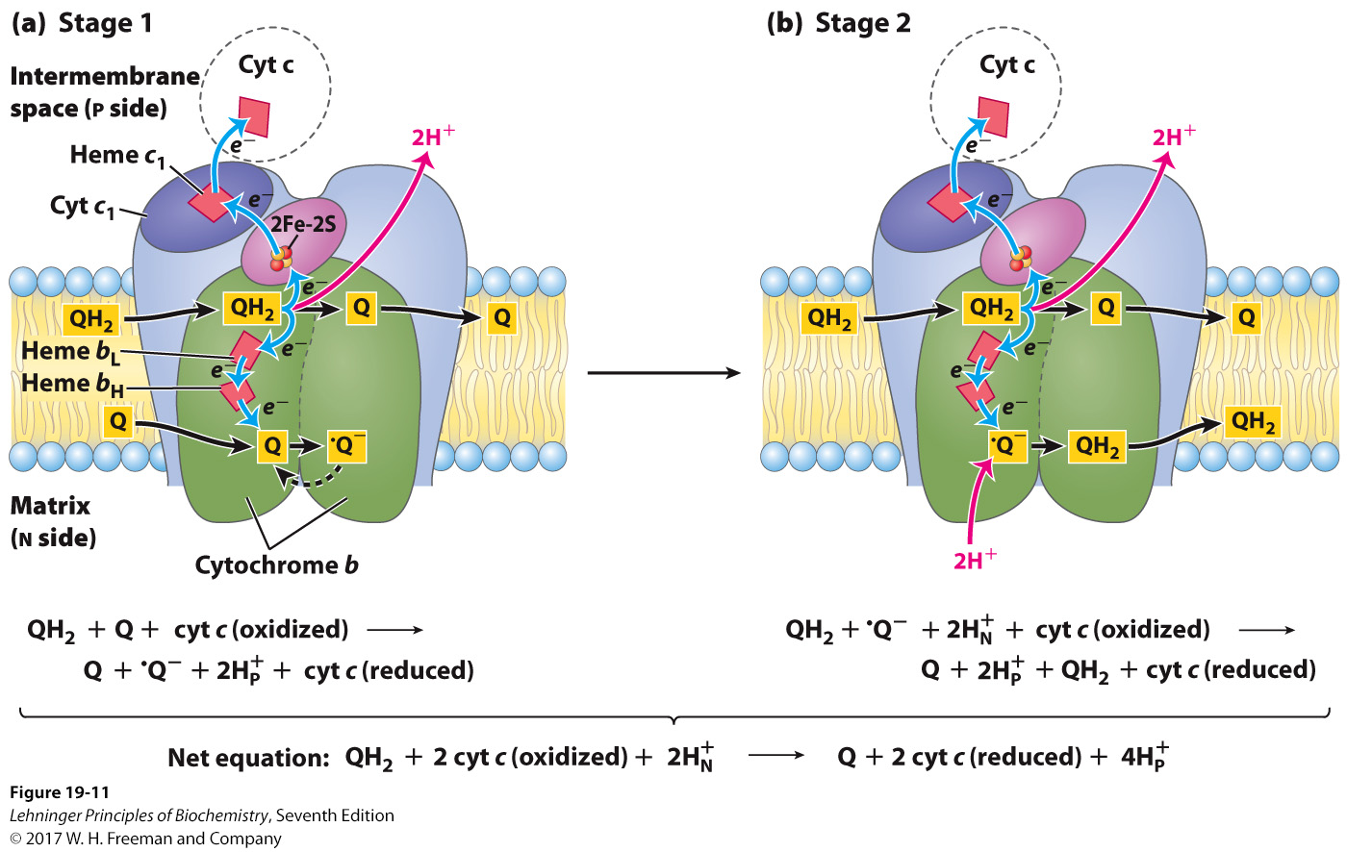
The Q Cycle: Overall Reaction
Notes:
FIGURE 19–12 The Q cycle, shown in two stages. The path of electrons through Complex III is shown with blue arrows; the movement of various forms of ubiquinone, with black arrows. (a) In the first stage, Q on the Nside is reduced to the semiquinone radical, which moves back into position to accept another electron. (b) In the second stage, the semiquinone radical is converted to QH2. Meanwhile, on the P side of the membrane, two molecules of QH2 are oxidized to Q, releasing two protons per Q molecule(four protons in all) into the inter membrane space. Each QH2 donates one electron (via the Rieske Fe-S center) to cytochrome c1, and one electron(via cytochrome b) to a molecule of Q near the N side, reducing it in two steps to QH2. This reduction also consumes two protons per Q, which are taken up from the matrix (N side). Reduced cytochrome c1 passes electrons one at a time to cytochrome c, which dissociates and carries electrons to Complex IV. In each cycle, one reduction of Q at the QN site is coupled with two oxidations of QH2 at the QP site by consuming two protons from the matrix and releasing four protons into the inter membrane space.

Slide 33
The Q Cycle
Experimentally, four protons are transported across the membrane per two electrons that reach cyt c.
Two of the four protons come from QH₂.
The Q cycle provides a good model that explains how two additional protons are picked up from the matrix.
Two molecules of QH₂ become oxidized, releasing protons into the IMS.
One molecule becomes rereduced, thus a net transfer of four protons per reduced coenzyme Q.

Slide 34
Cytochrome c
The second mobile electron carrier
Ubiquinone moves through the membrane.
Cytochrome c moves through the intermembrane space.
A soluble heme-containing protein in the intermembrane space
Heme iron can be either ferrous (Fe³⁺, oxidized) or ferric (Fe²⁺, reduced).
Cytochrome c carries a single electron from the cytochrome bc₁ complex to cytochrome oxidase.
Notes:
FIGURE 19–4a (part 2) Prosthetic groups of cytochromes. (a) Each group consists of four five-membered, nitrogen-containing rings in a cyclic structure called a porphyrin. The four nitrogen atoms are coordinated with a central Fe ion, either Fe²⁺ or Fe³⁺. Iron protoporphyrin IX is found in b-type cytochromes and in hemoglobin and myoglobin (see Fig. 4–17). Heme c is covalently bound to the protein of cytochrome c through thioether bonds to two Cys residues. Heme a, found in a-type cytochromes, has a long isoprenoid tail attached to one of the five-membered rings. The conjugated double-bond system (shaded light red) of the porphyrin ring has delocalized π electrons that are relatively easily excited by photons with the wavelengths of visible light, which accounts for the strong absorption by hemes (and related compounds) in the visible region of the spectrum.

Slide 35
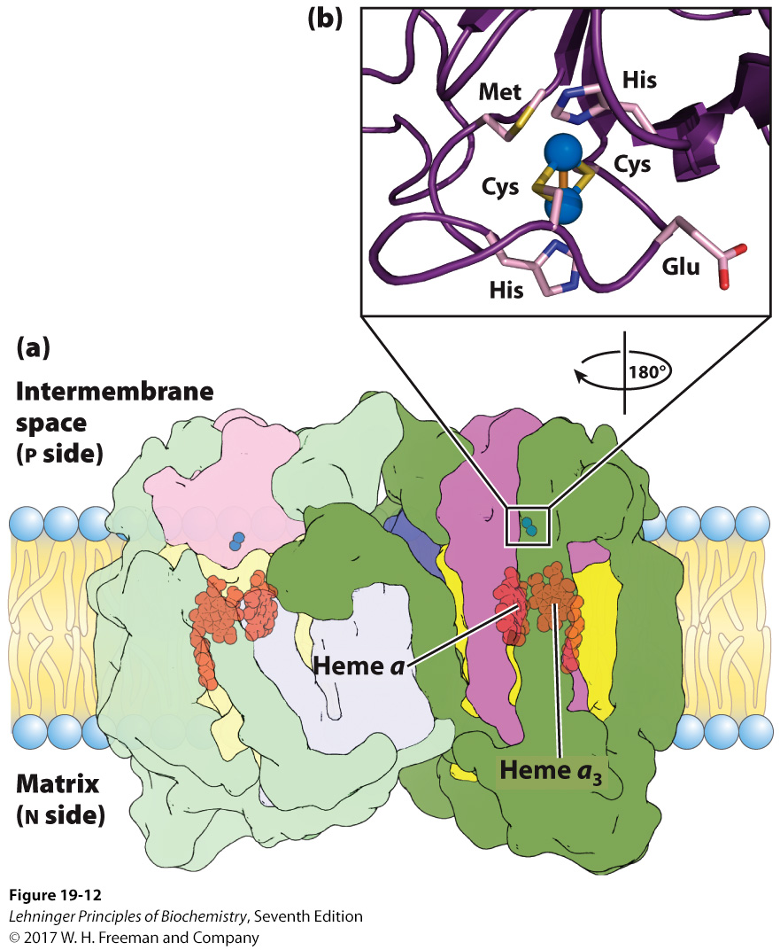
Complex IV: Cytochrome Oxidase
Contains two heme groups: a and a₃
Contains copper ions
Cu_{A}: two ions that accept electrons from cyt c
Cu_{B}: bonded to heme a₃, forming a binuclear center that transfers four electrons to oxygen
Notes:
FIGURE 19–12 Structure of Complex IV (cytochrome oxidase). (a) This complex (bovine) has 13 subunits in each identical monomer of its dimeric structure. Subunit I (yellow) has two heme groups, a and a3, near a single cop-per ion, CuB (not visible here). Heme a3 and CuB form a binuclear Fe-Cu center. Subunit II (purple) contains two Cu ions complexed with the OSH groups of two Cys residues in a binuclear center, CuA, that resembles the 2Fe-2S center sof iron-sulfur proteins. This binuclear center and the cytochrome c–binding site are located in a domain of subunit II that protrudes from the P side of the inner membrane (into the inter membrane space). Subunit III (blue) is essential for rapid proton movement through subunit II. The roles of the other 10subunits in mammalian Complex IV (green) are not fully understood, although some function in assembly or stabilization of the complex. (b) The binuclearcenter of CuA. The Cu ions (blue spheres) share electrons equally. When the center is reduced, the ions have the formal charges Cu11Cu11; when oxidized,Cu1.51Cu1.51. Six amino acid residues are ligands around the Cu ions: Glu, Met, two His, and two Cys.

Slide 36
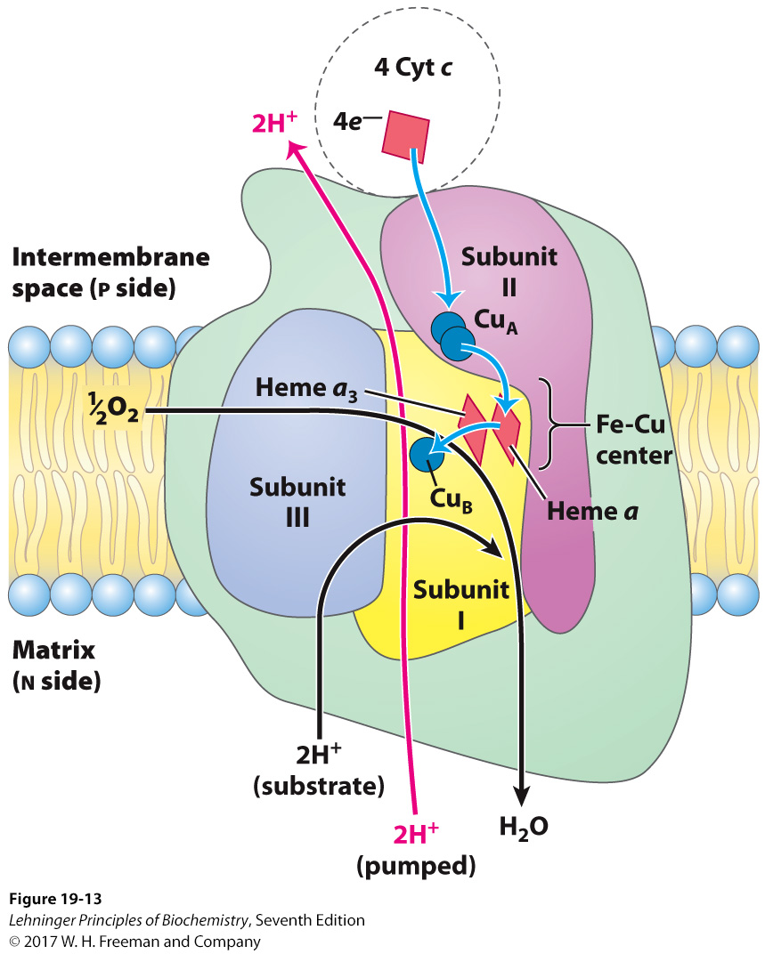
Electron Flow Through Complex IV
Cytochrome Oxidase Passes Electrons to O₂
2
Two electrons are used to reduce ½ of an oxygen molecule into a water molecule.
Two protons are passed to the intermembrane space.
2
Notes:
FIGURE 19–13 Path of electrons through Complex IV. For simplicity, only one monomer of the dimeric bovine Complex IV is shown. The three proteins critical to electron flow are subunits I, II, and III. The larger green structure includes the other 10 proteins in each monomer of the dimeric complex. Electron transfer through Complex IV begins with cytochrome c (top). Two molecules of reduced cytochrome c each donate an electron to the binuclear center CuA. From here, electrons pass through heme a to the Fe-Cu center(heme a3 and CuB). Oxygen now binds to heme a3 and is reduced to its per-oxy derivative (O2/2; not shown here) by two electrons from the Fe-Cu center. Delivery of two more electrons from cytochrome c (top), for a total of four electrons, converts the O2/2 to two molecules of water, with consumption of four “substrate” protons from the matrix. At the same time, two protons are pumped from the matrix for each pair of electrons passing through ComplexIV, by a mechanism not fully understood. Note that reduction of O2 to 2H2Orequires four electrons, or two pairs of electrons.

Slide 37
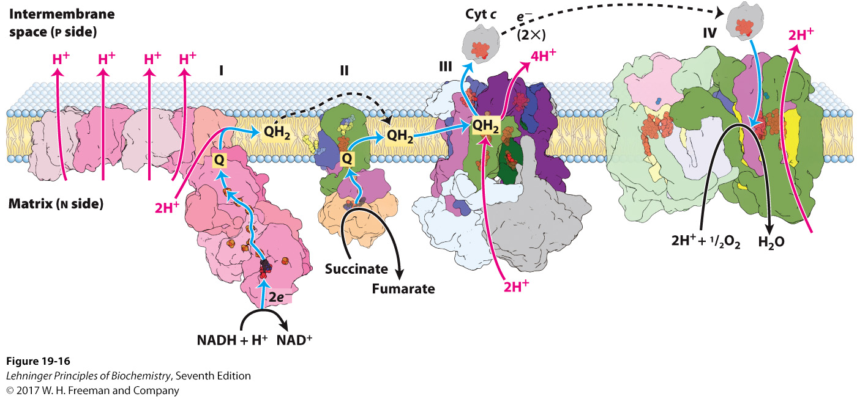
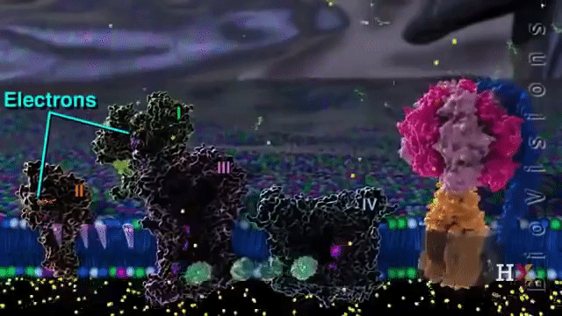
Summary of the Electron Flow in the Respiratory Chain
Notes:
FIGURE 19–16 Summary of the flow of electrons and protons through the four complexes of the respiratory chain. Electrons reach Q through Complexes I and II. The reduced Q (QH₂) serves as a mobile carrier of electrons and protons. It passes electrons to Complex III, which passes them to another mobile connecting link, cytochrome c. Complex IV then transfers electrons from reduced cytochrome c to O2. Electron flow through Complexes I, III, and IV is accompanied by proton flow from the matrix to the intermembrane space. Recall that electrons from β oxidation of fatty acids can also enter the respiratory chain through Q (see Fig. 19–8). The structures shown here are from several sources: Complex I, Thermus thermophilus (PDB ID 3M9S); Complex II, porcine heart (PDB ID 1ZOY); Complex III, bovine heart (PDB ID 1BGY); cytochrome c, equine heart (PDB ID 1HRC); Complex IV, bovine heart (PDB ID 1OCC).

Slide 38
Summary of Electron Transport
Complex I → Complex IV
1NADH + 11H⁺_{(N)} + ½O₂ ——> NAD⁺ + 10H⁺_{(P)} + H₂O
Complex II → Complex IV
FADH₂ + 6H⁺_{(N)} + ½O₂ ——> FAD + 6H⁺_{(P)} + H₂O
Difference in number of protons transported reflects differences in ATP synthesized.

Slide 39
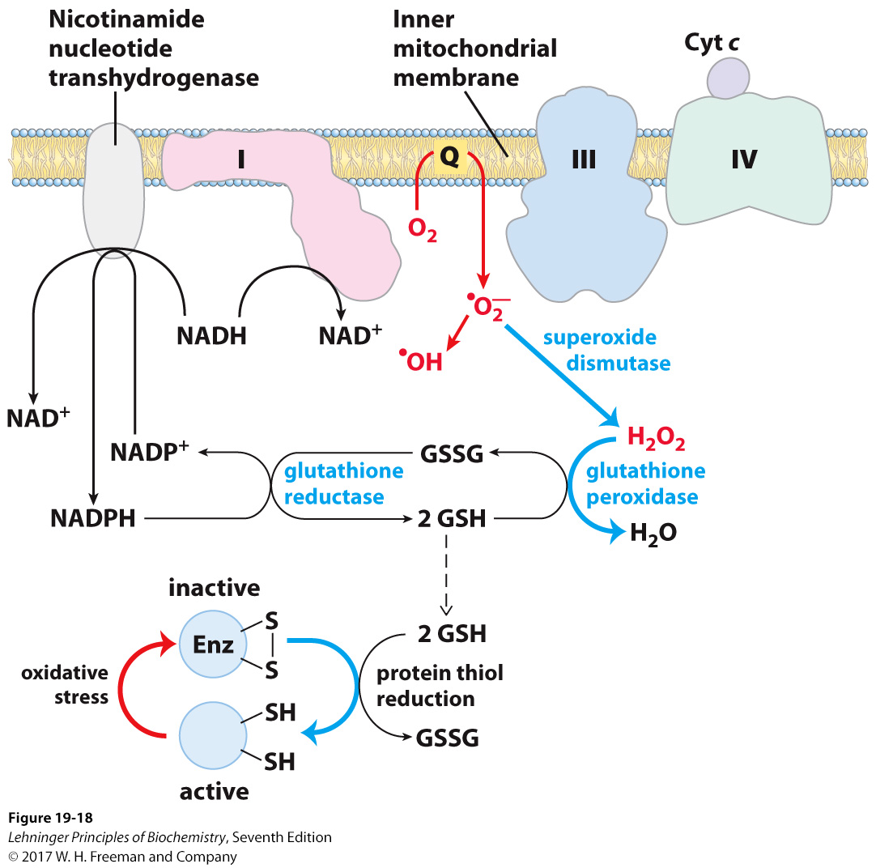
Reactive Oxygen Species Can Damage Biological Macromolecules
Ubiquinone is naturally “leaky” and facilitates partial reduction of non-Complex III targets.
Single electron tranfers result in free radicals.
One method by which the cell can correct free-radical production of reduced glutathione, which fuels the glutathione shuttle
Notes:
FIGURE 19–18 ROS formation in mitochondria and mitochondrial defenses. When the rate of electron entry into the respiratory chain and the rate of electron transfer through the chain are mismatched, superoxide radical (•O₂⁻) production increases at Complexes I and III as the partially reduced ubiquinone radical (•Q⁻) donates an electron to O₂. Superoxide acts on aconitase, a 4Fe-4S protein, to release Fe²⁺. In the presence of Fe²⁺, the Fenton reaction leads to formation of the highly reactive hydroxyl free radical (•OH). The reactions shown in blue defend the cell against the damaging effects of superoxide. Reduced glutathione (GSH; see Fig. 22–29) donates electrons for the reduction of H₂O₂ and of the oxidized Cys residues (—S—S—) of enzymes and other proteins, and GSH is regenerated from the oxidized form (GSSG) by reduction with NADPH.

Slide 40
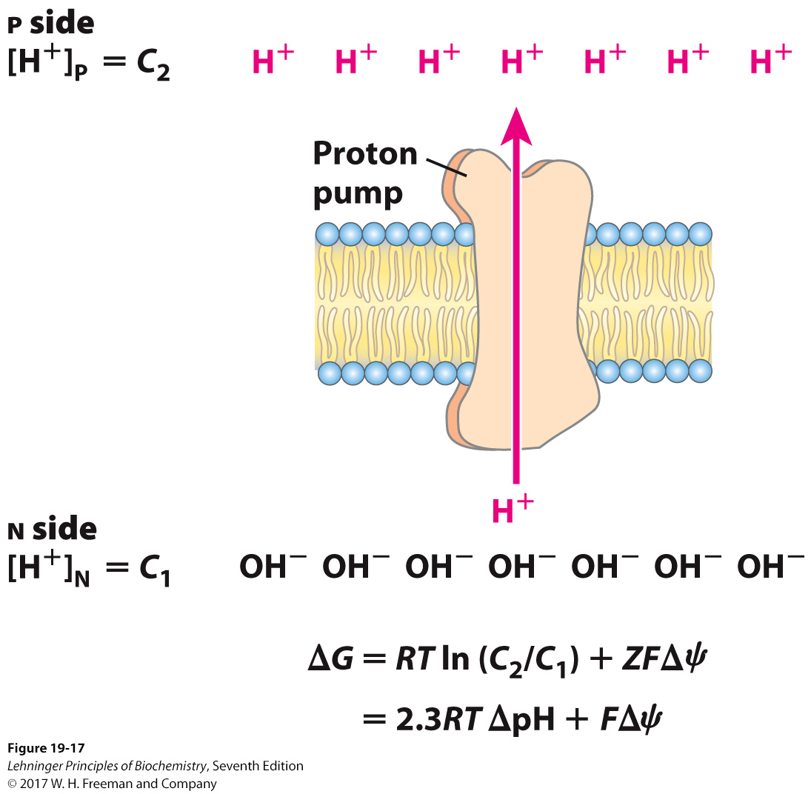
Proton-Motive Force
The proteins in the electron-transport chain created the electrochemical proton gradient by one of three means:
actively transporting protons across the membrane
Complex I and Complex IV
chemically removing protons from the matrix
reduction of CoQ and reduction of oxygen
releasing protons into the intermembrane space
oxidation of QH₂
Notes:
FIGURE 19–17 Proton-motive force. The inner mitochondrial membrane separates two compartments of different [H⁺], resulting in differences in chemical concentration (∆pH) and charge distribution (∆ψc) across the membrane. The net effect is the proton-motive force (∆G), which can be calculated as shown here. This is explained more fully in the text.

Slide 41
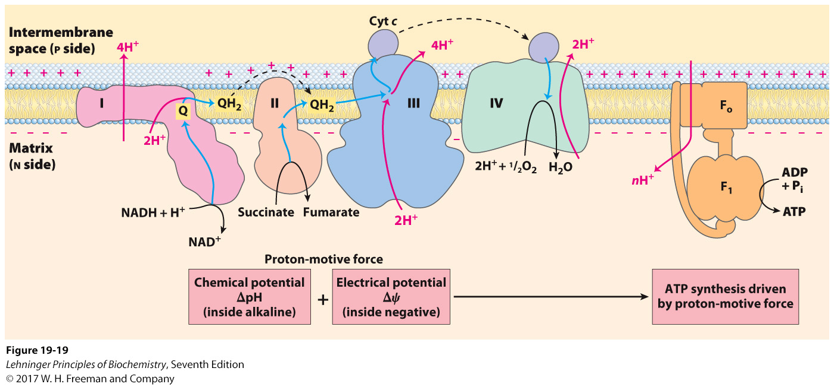
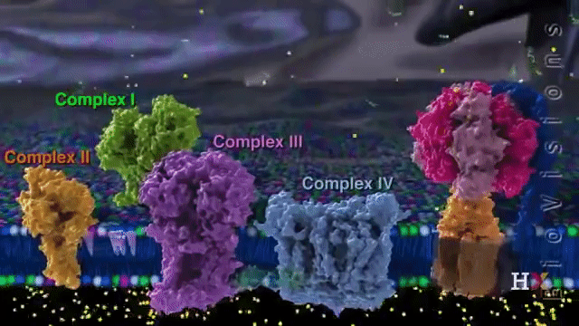
2
Chemiosmotic Model for ATP Synthesis
Electron transport sets up a proton-motive force.
Energy of proton-motive force drives synthesis of ATP.
Notes:
FIGURE 19–19 Chemiosmotic model. In this simple representation of the chemiosmotic theory applied to mitochondria, electrons from NADH and other oxidizable substrates pass through a chain of carriers arranged asymmetrically in the inner membrane. Electron flow is accompanied by proton transfer across the membrane, producing both a chemical gradient (∆pH) and an electrical gradient (∆ψ) (combined, the proton-motive force). The inner mitochondrial membrane is impermeable to protons; protons can reenter the matrix only through proton-specific channels (F_{o}). The protonmotive force that drives protons back into the matrix provides the energy for ATP synthesis, catalyzed by the F₁ complex associated with F_{o}.

Slide 42
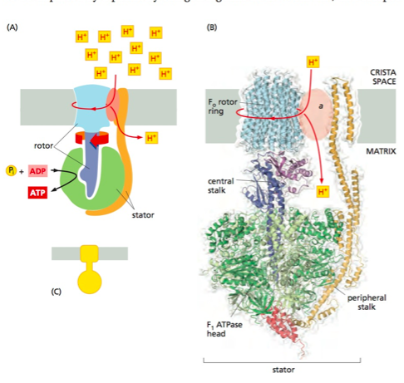
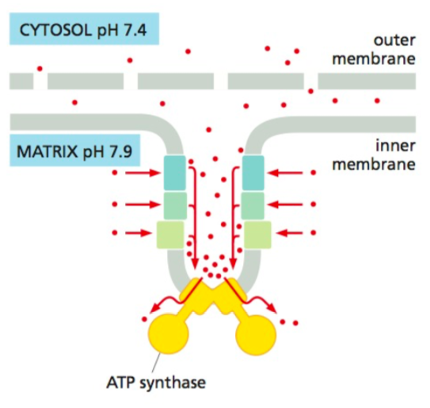
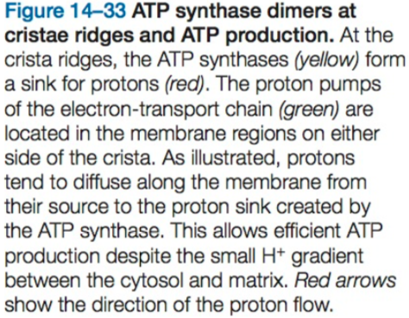
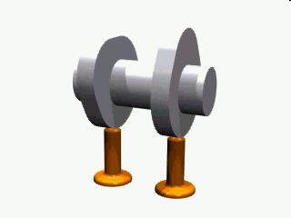
https://youtu.be/rdF3mnyS1p0

Slide 43
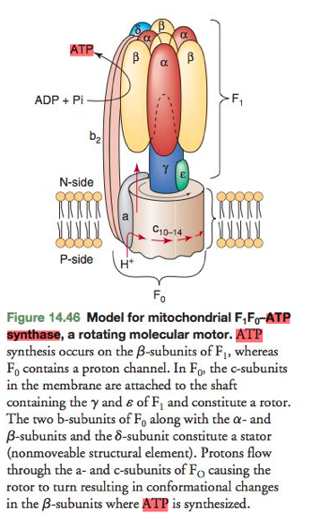
Mitochondrial ATP Synthase Complex
Contains two functional units:
F₁
soluble complex in the matrix
individually catalyzes the hydrolysis of ATP
F₀
integral membrane complex
transports protons from IMS to matrix, dissipating the proton gradient
energy transferred to F₁ to catalyze phosphorylation of ADP

Slide 44
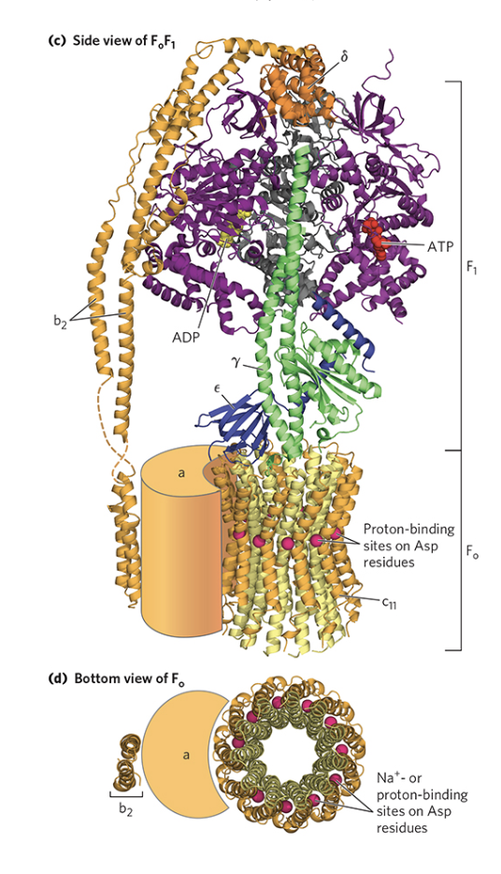
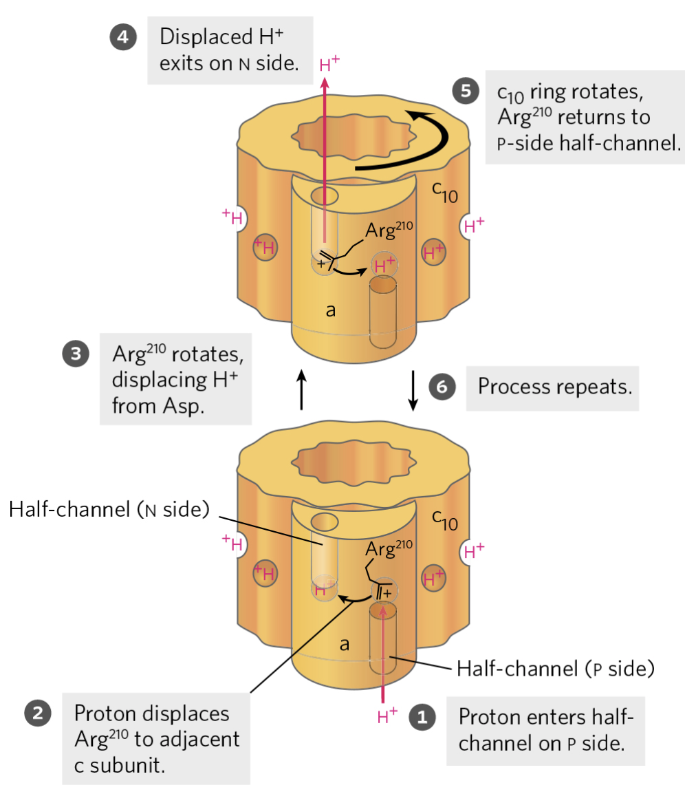
The rate of rotation in intact mitochondria has been estimated at about 6,000 rpm—100 rotations per second.

Slide 45
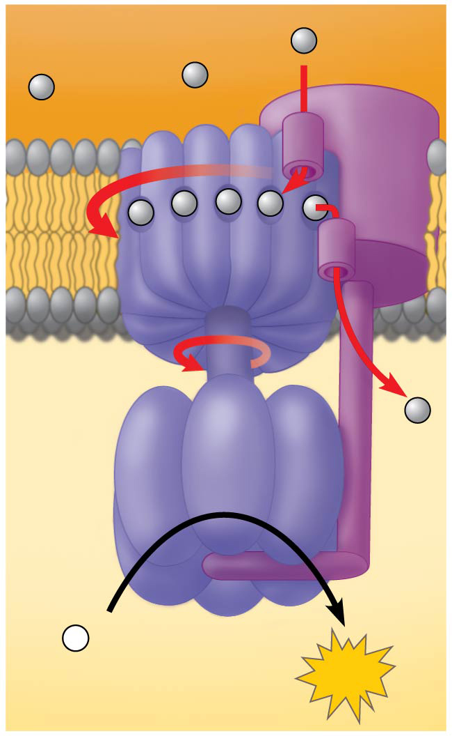
ATP Synthase
INTERMEMBRANE
SPACE
H+
Stator
H+
Rotor
H+
1) A rotor within the membrane spins as shown when H⁺ flows past it down the H⁺ gradient.
H+
H+
H+
H+
3) A rod (or “stalk”) extending into the knob also spins, activating catalytic sites in the knob.
Internal rod
Catalytic
knob
H+
2) A stator anchored in the membrane holds the knob stationary.
4) Three catalytic sites in the stationary knob join inorganic phosphate to ADP to make ATP.
ADP
+
P
i
MITOCHONDRIAL
MATRIX
ATP

Slide 46
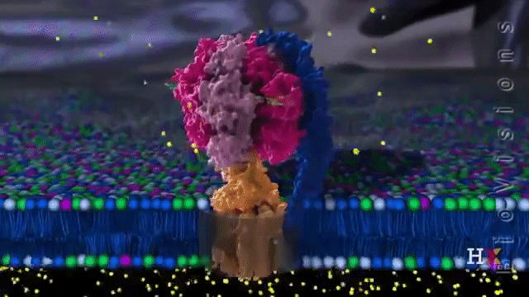
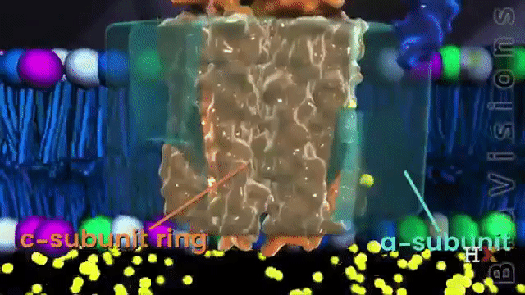

Slide 47
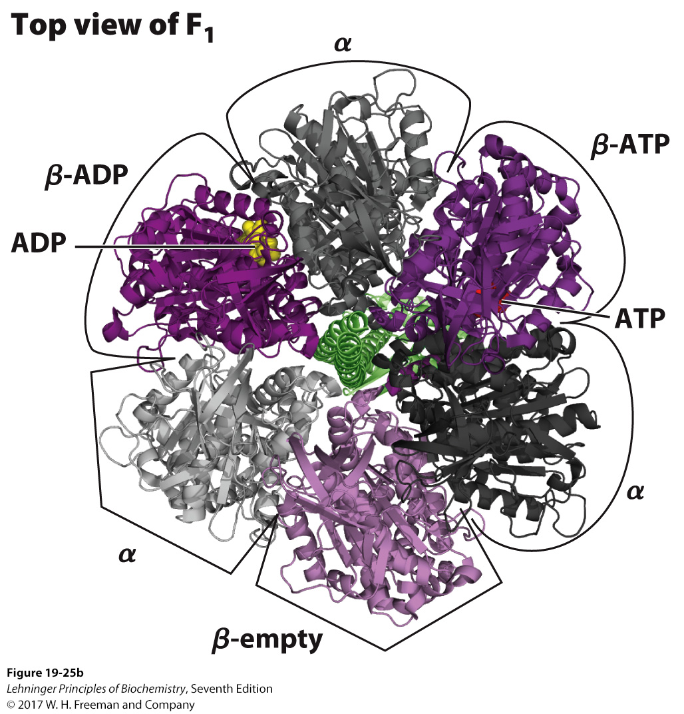
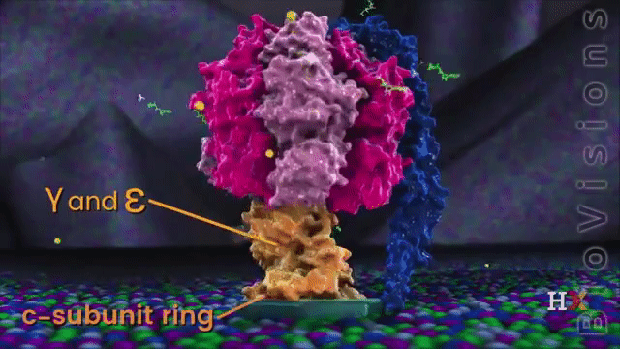
The F₁ catalyzes ADP + P_{i} ATP
Hexamer arranged in three αβ dimers
Dimers can exist in three different conformations:
open: empty
loose: binding ADP and P_{i}
tight: catalyzes ATP formation and binds product
Notes:
FIGURE 19–25b Mitochondrial ATP synthase complex. (b) (PDB ID 1BMF and PDB ID 1JNV) F₁ viewed from above (that is, from the N side of the membrane), showing the three β (shades of purple) and three α (shades of gray) subunits and the central shaft (γ subunit, green). Each β subunit, near its interface with the neighboring α subunit, has a nucleotide-binding site critical to the catalytic activity. The single γ subunit associates primarily with one of the three αβ pairs, forcing each of the three β subunits into slightly different conformations, with different nucleotide-binding sites. In the crystalline enzyme, one subunit (β-ADP) has ADP (yellow) in its binding site, the next (β-ATP) has ATP (red), and the third (β-empty) has no bound nucleotide.

Slide 48
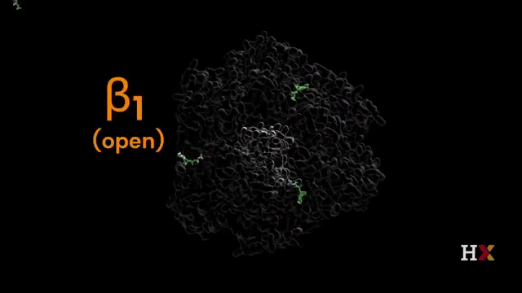
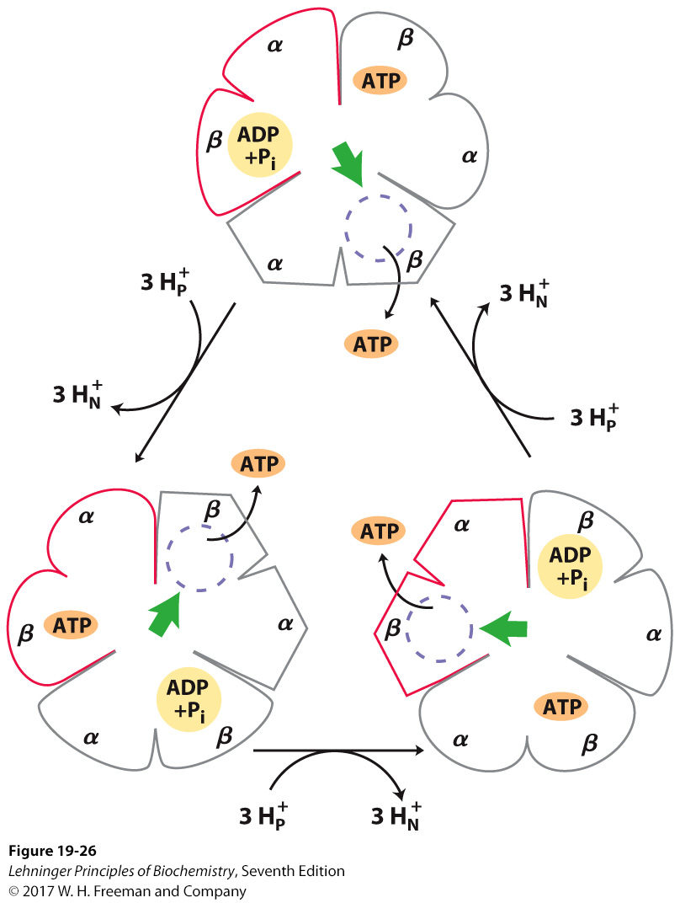
Binding-Change Model
β-ADP (loose-binding)
Translocation of three protons fuels synthesis of one ATP.
the β-ATP conformation binds ATP tightly
the β-empty (very-loose-binding)
Notes:
FIGURE 19–26 Binding-change model for ATP synthase. The F₁ complex has three nonequivalent adenine nucleotide–binding sites, one for each pair of α and β subunits. At any given moment, one of these sites is in the β-ATP conformation (which binds ATP tightly), a second is in the β-ADP (loose-binding) conformation, and a third is in the β-empty (very-loose-binding) conformation. The proton-motive force causes rotation of the central shaft—the γ subunit, shown as a green arrowhead—which comes into contact with each αβ subunit pair in succession. This produces a cooperative conformational change in which the β-ATP site is converted to the β-empty conformation, and ATP dissociates; the β-ADP site is converted to the β-ATP conformation, which promotes condensation of bound ADP + P_{i} to form ATP; and the β-empty site becomes a β-ADP site, which loosely binds ADP + P_{i} entering from the solvent. This model, based on experimental findings, requires that at least two of the three catalytic sites alternate in activity; ATP cannot be released from one site unless and until ADP and P_{i} are bound at the other.

Slide 49
Coupling Proton Translocation to ATP Synthesis
Proton translocation causes a rotation of the F₀ subunit and the central shaft γ.
This causes a conformational change within all the three αβ pairs.
The conformational change in one of the three pairs promotes condensation of ADP and P_{i} into ATP.
https://youtu.be/A2my52zQA6k

Slide 50
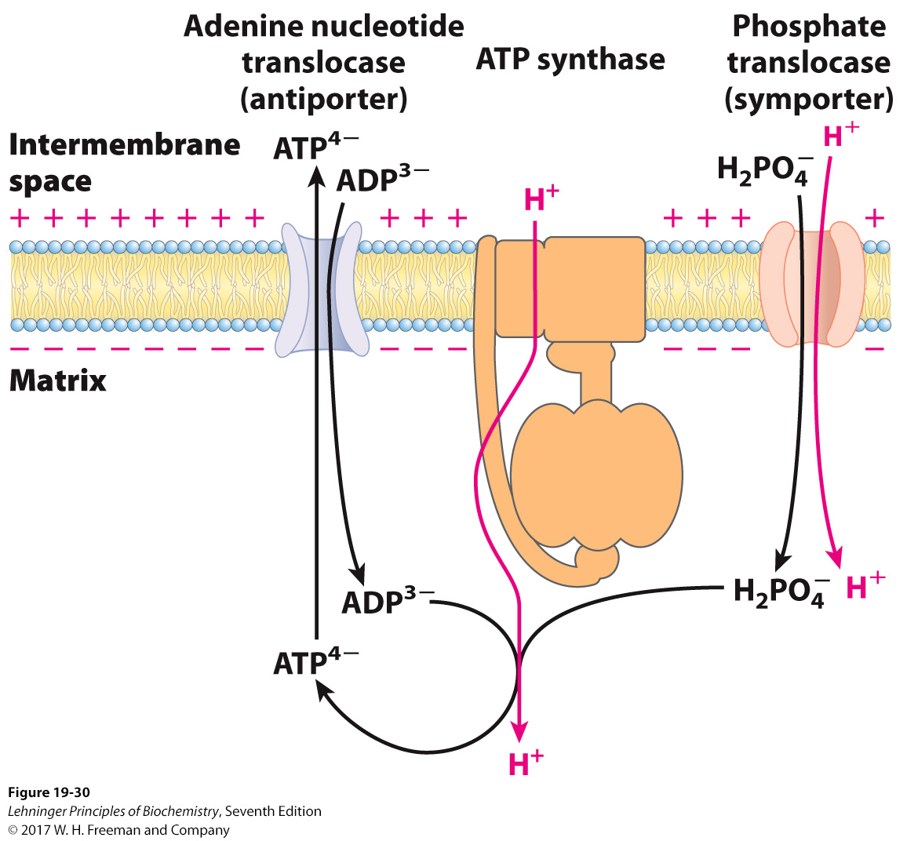
Transport of ADP and P_{i} into the Matrix
Translocation of a fourth proton per ATP is required to facilitate cotransport of substrates into and products out of the mitochondria.
Notes:
FIGURE 19–30 Adenine nucleotide and phosphate translocases. Transport systems of the inner mitochondrial membrane carry ADP and P_{i} into the matrix and newly synthesized ATP into the cytosol. The adenine nucleotide translocase is an antiporter; the same protein moves ADP into the matrix and ATP out. The effect of replacing ATP⁴⁻ with ADP³⁻ in the matrix is the net efflux of one negative charge, which is favored by the charge difference across the inner membrane (outside positive). At pH 7, P_{i} is present as both HPO₄²⁻ and H₂PO₄⁻; the phosphate translocase is specific for H₂PO₄⁻ . There is no net flow of charge during symport of H₂PO₄⁻ and H⁺, but the relatively low proton concentration in the matrix favors the inward movement of H⁺. Thus the proton-motive force is responsible both for providing the energy for ATP synthesis and for transporting substrates (ADP and P_{i}) into and product (ATP) out of the mitochondrial matrix. All three of these transport systems can be isolated as a single membranebound complex (ATP synthasome).

Slide 51
Net Production of ATP by Oxidation of Glucose (and Other Fuels) Varies
In prokaryotic systems, organelles do not segregate machinery, so all electron carriers can easily feed directly into the electron-transport chain.
In eukaryotic systems, organellar segregation prevents NADH from the cytosol from directly entering the electron-transport chain at Complex I.
NAD⁺ pools are kept segregated and cannot directly cross the mitochondrial inner membrane.
Two methods are used to feed the electrons from NADH from the cytosol into the mitochondria:
malate-aspartate shuttle
glycerol-3-phosphate shuttle

Slide 52
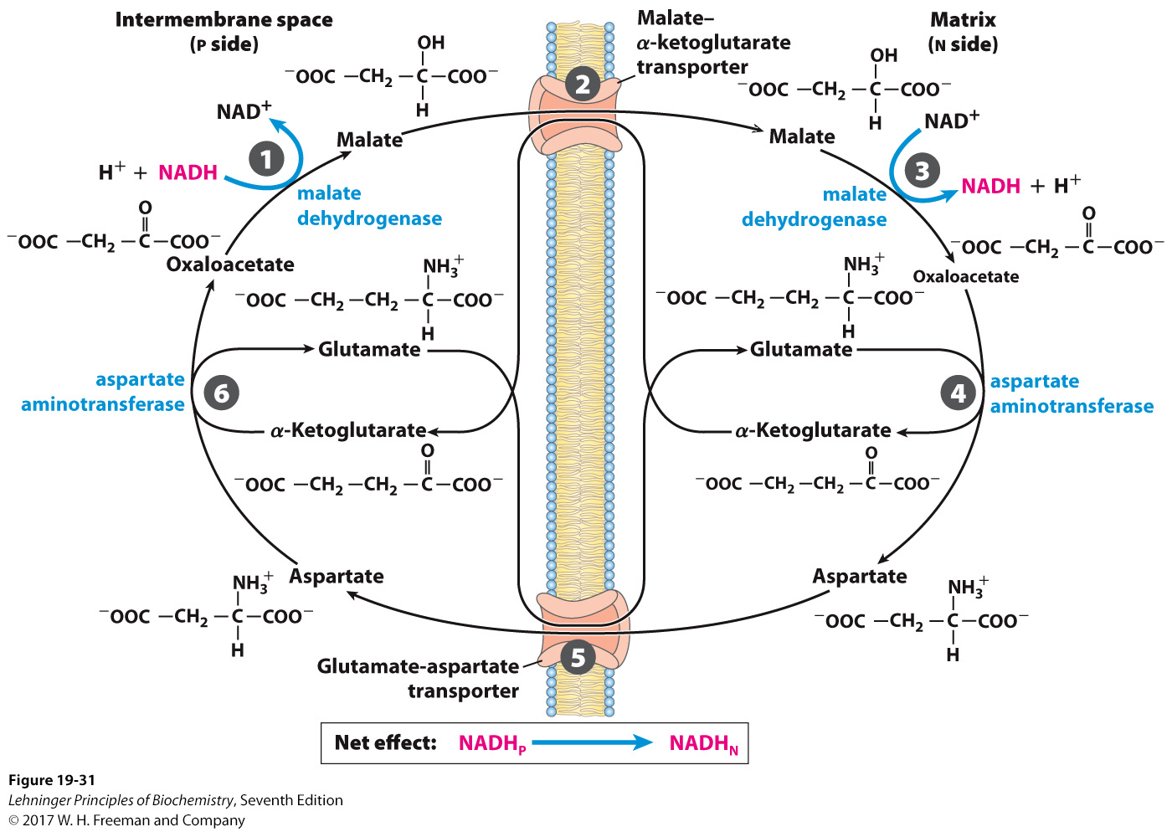
Malate-Aspartate Shuttle
Aspartate aminotransferase (AST) is an enzyme found in cells throughout the body but mostly in the heart and liver and, to a lesser extent, in the kidneys and muscles. In healthy individuals, levels of AST in the blood are low. When liver or muscle cells are injured, they release AST into the blood.
The liver, kidney, and heart mitochondria utilize the malate-aspartate shuttle to shuttle NADH to the matrix
Notes:
FIGURE 19–31 Malate-aspartate shuttle. This shuttle for transporting reducing equivalents from cytosolic NADH into the mitochondrial matrix is used in liver, kidney, and heart. 1 NADH in the cytosol enters the intermembrane space through openings in the outer membrane (porins), then passes two reducing equivalents to oxaloacetate, producing malate. 2 Malate crosses the inner membrane via the malate–α-ketoglutarate transporter. 3 In the matrix, malate passes two reducing equivalents to NAD⁺, and the resulting NADH is oxidized by the respiratory chain; the oxaloacetate formed from malate cannot pass directly into the cytosol. 4 Oxaloacetate is first transaminated to aspartate, and 5 aspartate can leave via the glutamate-aspartate transporter. 6 Oxaloacetate is regenerated in the cytosol, completing the cycle.

Slide 53
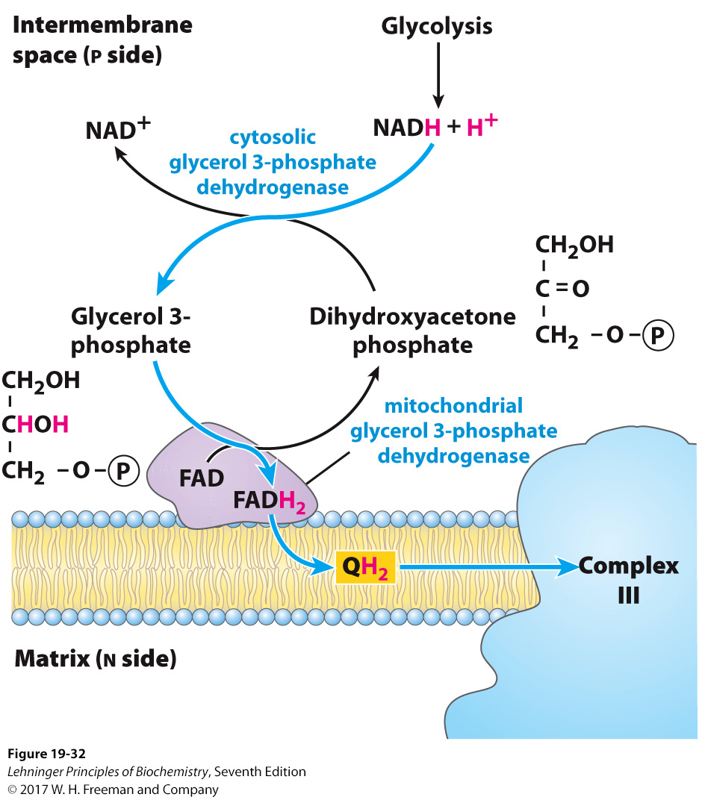
Glycerol-3-Phosphate Shuttle
Skeletal muscle and brain use the glycerol 3-phosphate shuttle
This does not use Complex I or Complex II
Notes:
FIGURE 19–32 Glycerol 3-phosphate shuttle. This alternative means of moving reducing equivalents from the cytosol to the mitochondrial matrix operates in skeletal muscle and the brain. In the cytosol, dihydroxyacetone phosphate accepts two reducing equivalents from NADH in a reaction catalyzed by cytosolic glycerol 3-phosphate dehydrogenase. An isozyme of glycerol 3-phosphate dehydrogenase bound to the outer face of the inner membrane then transfers two reducing equivalents from glycerol 3-phosphate in the intermembrane space to ubiquinone. Note that this shuttle does not involve membrane transport systems.

Slide 54
Net Production of ATP via Catabolic Pathways
TABLE 19-5 | ATP Yield from Complete Oxidation of Glucose
Process |  | Direct product | Final ATP
Glycolysis |  | 2 NADH (cytosolic) 2 ATP | 3 or 5a 2
Pyruvate oxidation (two per glucose) |  | 2 NADH (mitochondrial matrix) | 5
Acetyl-CoA oxidation in citric acid cycle (two per glucose) |  | 6 NADH (mitochondrial matrix) 2 FADH₂ 2 ATP or 2 GTP | 15 3 2
Total yield per glucose |  |  | 30 or 32
ªIf the malate/aspartate shuttle is used to transfer reducing equivalents into the mitochondrion, yield is 5 ATP. If the glycerol 3-phosphate shuttle is used, the yield is 3 ATP.

Slide 55


Relationship of ETC and ATP Synthesis
As described, ATP synthesis requires electron transport.
But electron transport does not requires ATP synthesis.
Cyanide (CN⁻), blocks electron transfer between cytochrome oxidase (Complex IV) and O2
Venturicidin &oligomycin are inhibitors of ATP synthase
Dinitrophenol (DNP) is an uncoupler
Intermembrane space
Matrix
Notes:
FIGURE 19–20 Coupling of electron transfer and ATP synthesis in mitochondria. In experiments to demonstrate coupling, mitochondria are suspended in a buffered medium and an O₂ electrode monitors O₂ consumption. At intervals, samples are removed and assayed for the presence of ATP. (a) Addition of ADP and P_{i} alone results in little or no increase in either respiration (O₂ consumption; black) or ATP synthesis (red). When succinate is added, respiration begins immediately and ATP is synthesized. Addition of cyanide (CN⁻), which blocks electron transfer between cytochrome oxidase (Complex IV) and O₂, inhibits both respiration and ATP synthesis. (b) Mitochondria provided with succinate respire and synthesize ATP only when ADP and P_{i} are added. Subsequent addition of venturicidin or oligomycin, inhibitors of ATP synthase, blocks both ATP synthesis and respiration. Dinitrophenol (DNP) is an uncoupler, allowing respiration to continue without ATP synthesis.

Slide 56

ATP Synthesis Can Be Uncoupled from ETC to Generate Heat
Uncoupling protein 1 (UCP-1) in babies
Hibernating animals
Notes:
FIGURE 19-36 Heat generation by uncoupled mitochondria. UCP1, the uncoupling protein in the mitochondria of brown adipose tissue, by providing an alternative route for protons to reenter the mitochondrial matrix, causes the energy conserved by proton pumping to be dissipated as heat.

Slide 57
Composition of Two Types of Fat Tissue
White adipose tissue (WAT)
made of large spherical cells (30–70 μm) filled with one lipid droplet
mitochondria and nucleus are squeezed to a layer near membrane
Brown adipose tissue (BAT)
smaller (20−40 μm), not round
have several lipid droplets
have more mitochondria
More cytochrome content gives it a brown color.
UCP1 (thermogenin) present

Slide 58

Adipocytes of WAT and BAT
Notes:
FIGURE 23–17 White and brown adipose tissue. Schematic views of typical mouse adipocytes from (a) white adipose tissue (WAT) and (b) brown adipose tissue (BAT). White adipocytes are larger and contain a single huge lipid droplet, which squeezes the mitochondria and nucleus against the plasma membrane. In brown adipocytes, mitochondria are much more prominent, the nucleus is near the center of the cell, and multiple small fat droplets are present. Below are light micrographs of (c) adipocytes in WAT, stained to show nuclei, and (d) a region of mixed white and brown adipocytes, stained with an antibody specific to UCP1.

Slide 59
Two Types of Fat Function
WAT serves as fuel storage
BAT expresses uncoupling protein UCP1 (thermogenin)
allows H⁺ gradient in mitochondrial to be dissipated
energy released as heat → process called thermogenesis
keeps organs warm in low-temp environments
BAT primarily in newborns, around kidneys, spine, and so on

Slide 60

Distribution of BAT
Notes:
FIGURE 23–18 Brown adipose tissue in infants and adults. (a) At birth, human infants have brown fat distributed as shown here, to protect the spine, major blood vessels, and the internal organs. (b) Positron emission tomography (PET) scanning can show metabolic activity in a living person, in real time. PET scans allow visualization of isotopically labeled glucose in precisely localized regions of the body. A positron-emitting glucose analog, 2-[¹⁸F]-fluoro-2-deoxy D-glucose (FDG), is injected into the bloodstream; a short time later, a PET scan shows how much of the glucose has been taken up by each part of the body—a measure of metabolic activity. On the left is a PET scan of a healthy 25-year-old man who fasted for 12 hours, then stayed for 1 hour in a cold (19 °C) room, with his legs on ice to thoroughly chill him. At the end of the hour, he was injected with [¹⁸F]-FDG, then remained under cold conditions for another hour. Whole-body PET scans were then done at 24 °C. For the control scan, the same man underwent the same PET scan protocol two weeks later, but this time following 2 hours at 27 °C instead of chilling (right). Intense labeling of the brain and heart shows high rates of glucose uptake; labeling of the kidneys and bladder indicates clearance of FDG. In the scan after chilling (left), [¹⁸F]-FDG labels BAT in the region above the collarbone and along the vertebrae.

